Slide 1




Global reach for Australian trials
Anna Nowak
MBBS FRACP PhD
Chair, CoOperative trials Group for NeuroOncology (COGNO)
Director, National Centre for Asbestos Related Diseases

Slide 2
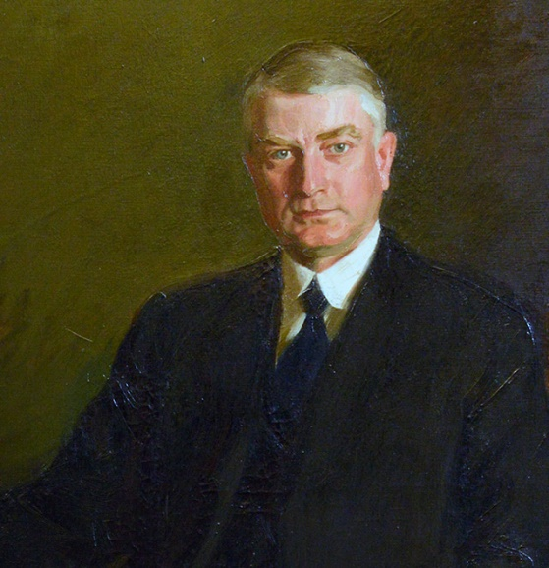
“The best interest of the patient is the only interest to be considered, and in order that the sick may have the benefit of advancing knowledge, union of forces is necessary”.
Dr William J Mayo, 1910

Slide 3
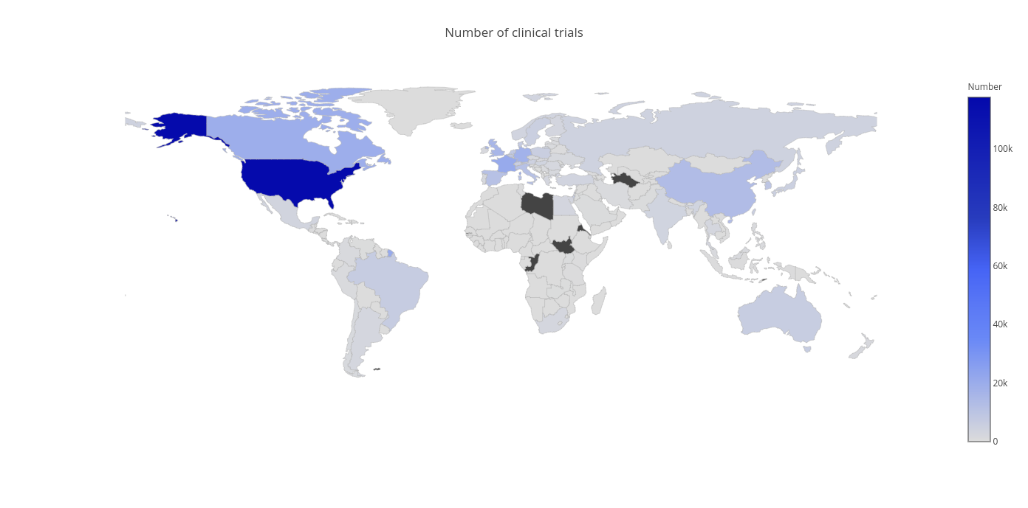
Globally – clinical trials and drug development is North-American focussed

Slide 4
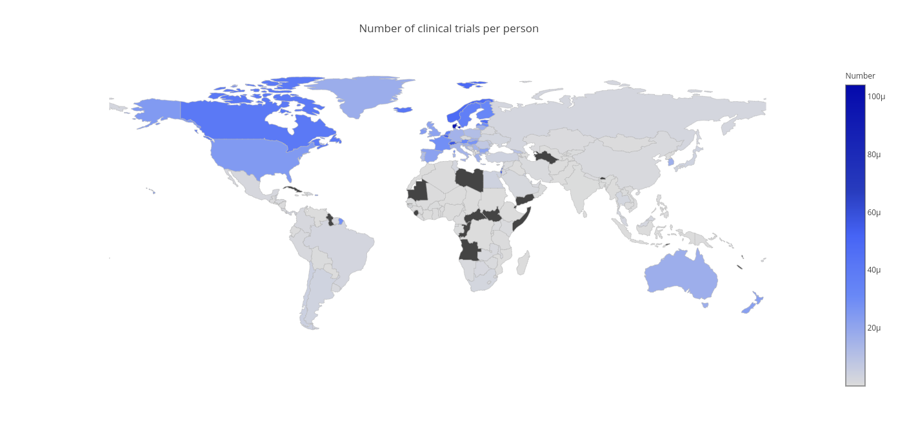
Globally – the number of clinical trials per capita

Slide 5


Slide 6
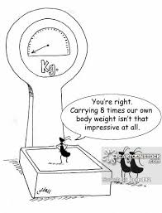
Historically – we import international clinical trials – but contribute disproportionately
CO-17 – collaboration between NCIC and AGITG
CATNON trial – EORTC led, we joined 2 years late, contributed >10% of patients and highest per capita recruitment by far
CODEL trial – Australia ready to go and funded before EORTC is open
GBM-AGILE – key Australian leadership from trial inception, significant Australian funding for core infrastructure
BR-31 – aiming to recruit almost 20% of global patients

Slide 7


Slide 8
Bringing international clinical trials TO Australia
Activity 1: Establishment of an International Clinical Research Subcommittee (ICRS) to build strategic capacity and collaboration for COGNO International clinical trials
This activity will increase access to high quality international trials and will enhance COGNO’s capacity to undertake a leadership role to improve therapies and outcomes for adults with brain cancer.
Activity 2: Extend COGNO collaborative partnership networks to facilitate Australian patient access to international trials.
This activity will lead to engagement and collaboration to maximise the availability of, and increase access to, brain cancer clinical trials for Australian patients.
Activity 3: Operationalise selected international trials in Australia.
This activity will directly lead to increased access to brain cancer clinical trials for Australian patients.
Notes:
This text is directly from the COGNO grant application.

Slide 9
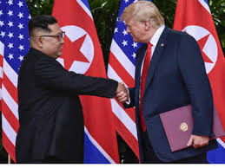
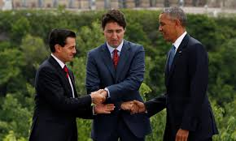
Reaching out internationally

Slide 10
The ASPREE study
ASPREE study (ASPirin in Reducing Events in the Elderly)
  Led from Monash University
  19,000 participants in Australia and the USA
Demonstrated that low dose aspirin for primary prevention in the elderly had a significantly higher risk of major haemorrhage and did not result in a lower risk of cardiovascular disease than placebo

Slide 11
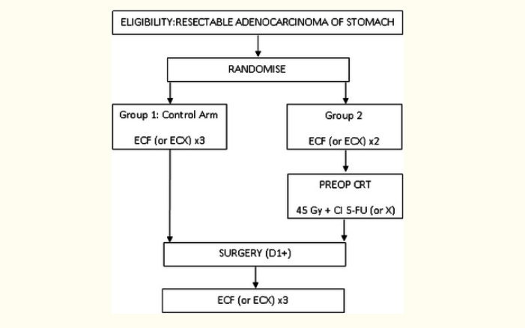
TOPGEAR study
Randomised phase III trial of perioperative ECF chemotherapy vs preoperative chemoradiation + perioperative ECF chemo for resectable gastric cancer
Will resolve dilemma between two alternative neoadjuvant strategies
International intergroup trial
  AGITG, TROG, EORTC, NCIC, CTG
N=752
PI Prof Trevor Leong (Peter Mac)

Slide 12
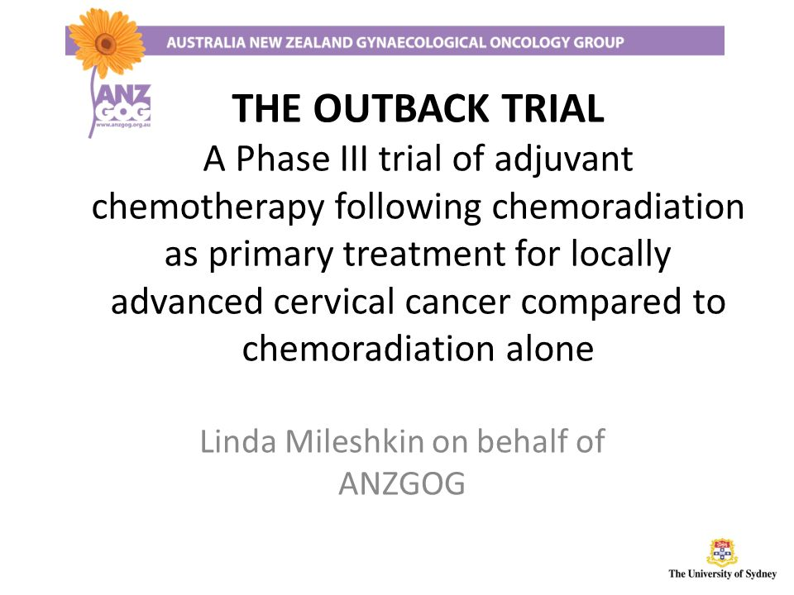
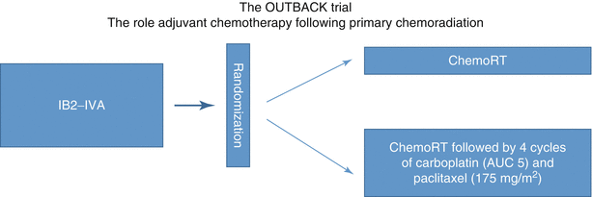
OUTBACK study
Primary objective - to determine if adding adjuvant chemotherapy to chemo-radiation improves survival in women with locally advanced cervical cancer.
Participating groups include ANZGOG, GOG, RTOG – ANZ, USA, Saudi Arabia, and Canada
N=780
PI Linda Mileshkin

Slide 13



The DREAM3R study
DuRvalumab and chEmotherApy in malignant pleural Mesothelioma: a phase 3 Randomised clinical trial

Slide 14
The DREAM study
Trial design – Single-arm, multicentre phase II trial with a safety run-in, N= 54
Population
1st line MPM
Non-surgical
No prior RT to measurable disease
ECOG PS 0-1
No PD-L1 selection
Induction
Maintenance
Outcomes
PFS6*
ORR (CR + PR)* Toxicity
PFS*
OS
* mRECIST for MPM, mirRC
Cisplatin 75mg/m² + Pemetrexed 500mg/m² + Durvalumab 1125mg q3w
Durvalumab 1125mg
q3w x 52 w
6 cycles
To total 17 cycles durvalumab including induction period (12 months from treatment start)

Slide 15
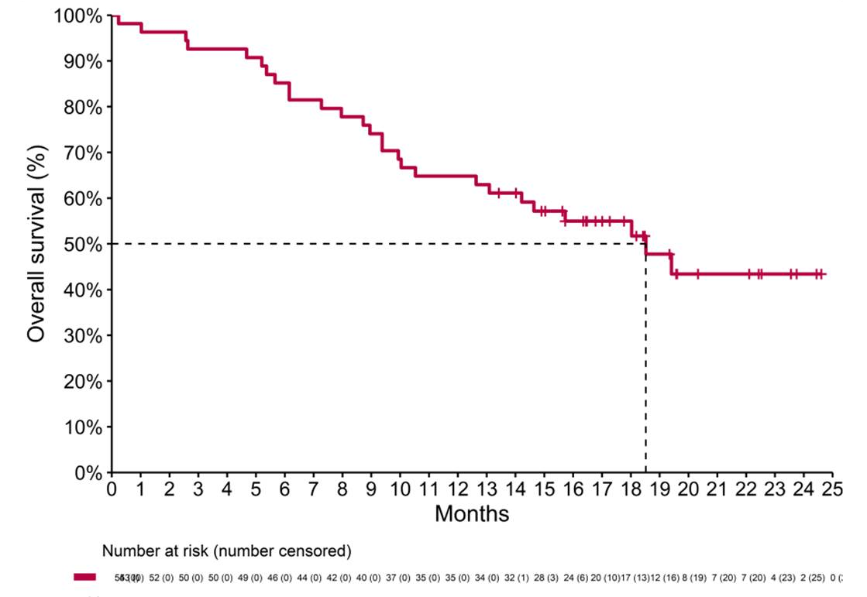
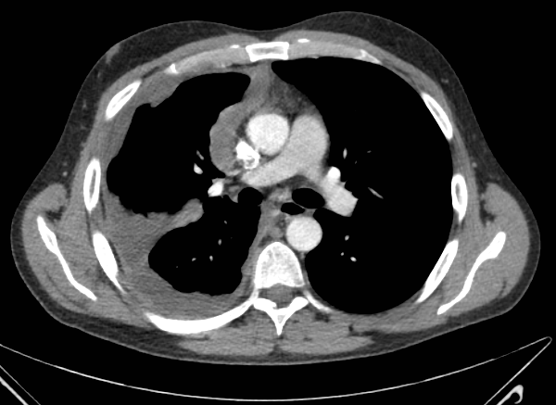
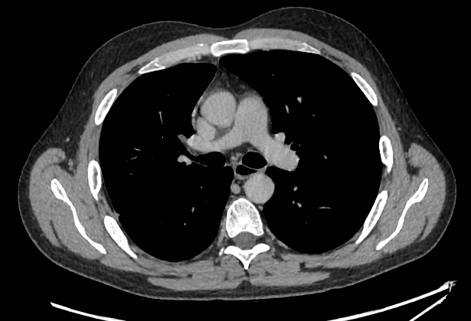
DREAM trial – exciting phase II results

Slide 16
The DREAM3R study
Trial design – Randomised, open label international multicentre phase III trial N= 400+
Induction
Maintenance
Population
1st line MPM
Non-surgical
No prior RT to measurable disease
ECOG PS 0-1
No PD-L1 selection
Any histology
Endpoints
Primary: OS
Secondary:
*PFS
*ORR (CR + PR) Toxicity
*HRQoL
*Translational
*Health Economics
OS
mRECIST for MPM, mirRC
Cisplatin 75mg/m² + Pemetrexed 500mg/m² + Durvalumab 1120mg q3w
Durvalumab 1500mg
Q4w ongoing
R
Cisplatin 75mg/m² + Pemetrexed 500mg/m²
Observation
6 cycles
To progression, intolerance, or patient discontinuation for other reasons

Slide 17
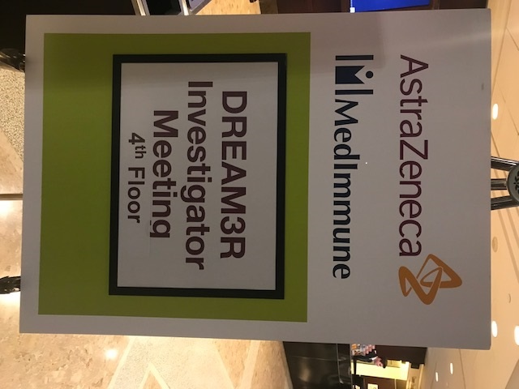
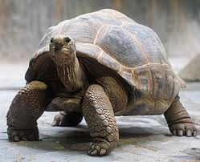
DREAM3R timelines
WCLC 2017 – discussion with stage 1 data from DREAM
ASCO May 2018 – discussion with confidential full data from DREAM
Post ASCO June/July 2018
  Study concept submitted
  Contact with PrECOG
  Teleconferencing with PrECOG – collaborate and study design
WCLC October 2018 – joint meeting ALTG/PrECOG/AZ
Post WCLC Nov-Dec 2018
  Regular TCs with PrECOG +/- AZ
January 2019 – meeting with AZ Global Senior Executive Team in Sydney
February/March 2019 – more TCs and real action

Slide 18

What I have learnt – the good
Australia can lead trials in the international arena
International involvement can multiply recruitment for rare cancers or less common clinical scenarios
Other groups will let us take the lead
We have the expertise to run registration trials with multiple jurisdictions involved
Definitely less costly than pharma trials
Probably less costly than US-led trials
Australia has key strengths – PROs, specific translational studies
Our people hold their own internationally
  Professionalism, expertise, ideas, conviction, experience

Slide 19

What I have learnt – the challenges
Pace of decision-making with multiple players involved
Time zones are the natural enemy of international collaboration!
Different models of clinical trial operations may need to be considered
  Eg. Japan
International governance and legal/contractual frameworks
Generating trust with few face to face meetings
Drug distribution networks can be barriers
Translation of study materials
Biomarkers – shipping and storage

Slide 20
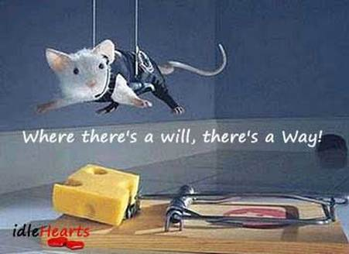
What I have learnt – the models
Single global cooperative group
  E.g. TACT, BIG
Equal partnership between two or more national cooperative groups (Intergroup model)
  E.g. ALTG and PrECOG – each acts as sponsor in region
Australian co-operative group leads trial internationally
  Local sponsors required
Parallel studies with identical design
  Intended for subsequent combined analysis

Slide 21


Slide 22
Thank you
Acknowledgement: the many inspirational, talented and hard working NHMRC CTC oncology leaders and trials staff I have worked with over the years

