Slide 1
Molecular & Genomic driven trials Precision Medicine
Mustafa Khasraw
Medical Oncologist @ RNSH
Clinical Lead @ the NHMRC Clinical Trials Centre

Slide 2
Precision Medicine (PM)
Prevention and treatment strategies that take individual variability into account
Personalized Medicine
Creation of medical treatments unique to the particular patient

Slide 3
Why Precision Medicine?
In 2015, the Precision Medicine Initiative was launched by the US government through the National Institute of Health with a US$215M budget to accelerate implementation of precision medicine into standard clinical practice
In 2018, the Australian Genomics Health Futures Mission was launched by the with a AU$500M budget as part of the National Health and Medical Industry Growth Plan and the aim to enable practitioners to tailor treatment for each patients through genomics technology and precision medicine innovation

Slide 4
Precision Medicine
Prospect of PM improved by:
Large-scale biologic databases (such as the human genome sequence)
Patient characterization: proteomics, metabolomics, genomics, cellular assays
Health technology
Computational tools/ large data sets

Slide 5
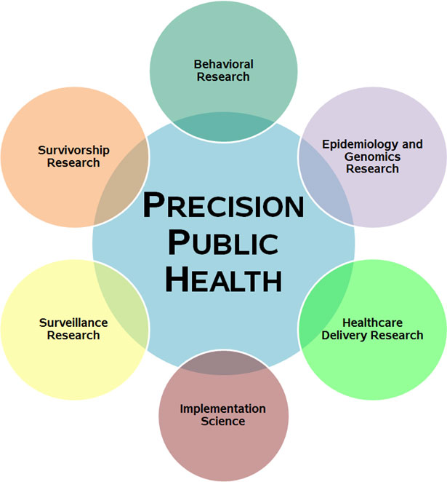

Slide 6
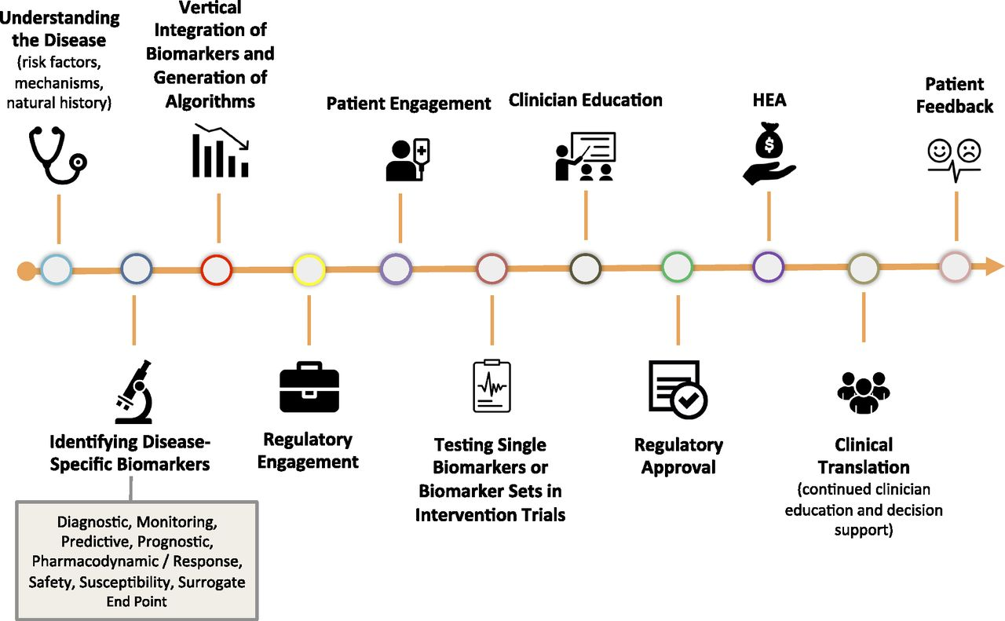
PM in type 2 DM
Hugo Fitipaldi et al. Diabetes 2018;67:1911-1922
Notes:
The path to precision medicine in type 2 diabetes. HEA, health economic assessment.

Slide 7
Oncology is well suited for PM?
Many cancers driven by molecular aberrations?
Each cancer has own signature, with tumor-specific features and features common to multiple tumors?
Cancers are a consequence of accumulating genomic damage?
Inherited genetic variations contribute to cancer risk?
This understanding has influenced risk assessment, diagnostic categories, and therapeutic strategies?
Drugs and antibodies have been developed designed to counter specific molecular drivers?
Molecular signatures may be strong predictors of benefit?

Slide 8
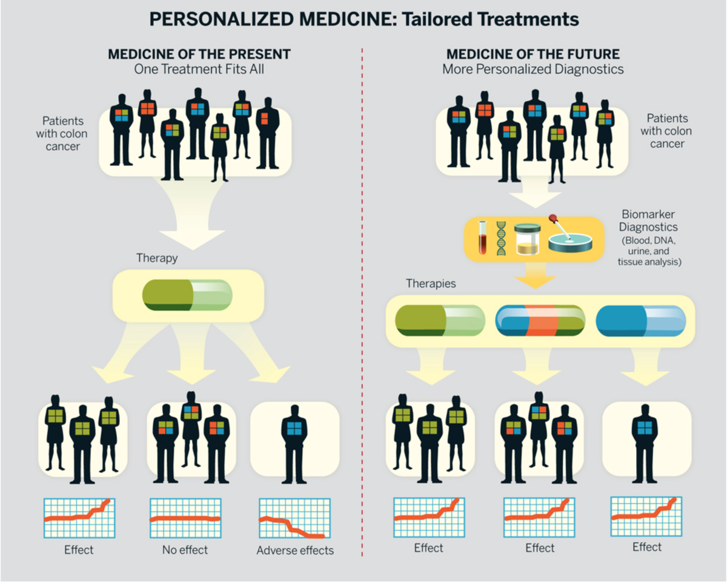

Slide 9
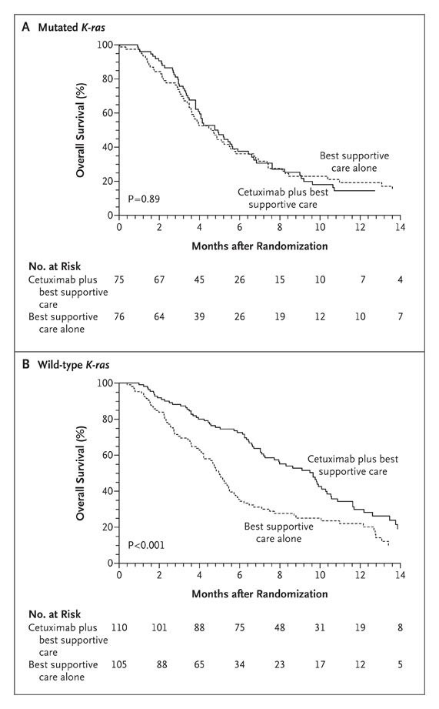
Karapetis CS et al. N Engl J Med 2008;359:1757-1765.
Kaplan–Meier Curves for Overall Survival According to Treatment.
Notes:
Figure 1. Kaplan–Meier Curves for Overall Survival According to Treatment. Panel A shows results for patients with mutated K-ras tumors, and Panel B for patients with wild-type K-ras tumors. Cetuximab as compared with best supportive care alone was associated with improved overall survival among patients with wild-type K-ras tumors but not among those with mutated K-ras tumors. The difference in treatment effect according to mutation status was significant (test for interaction, P=0.01).

Slide 12
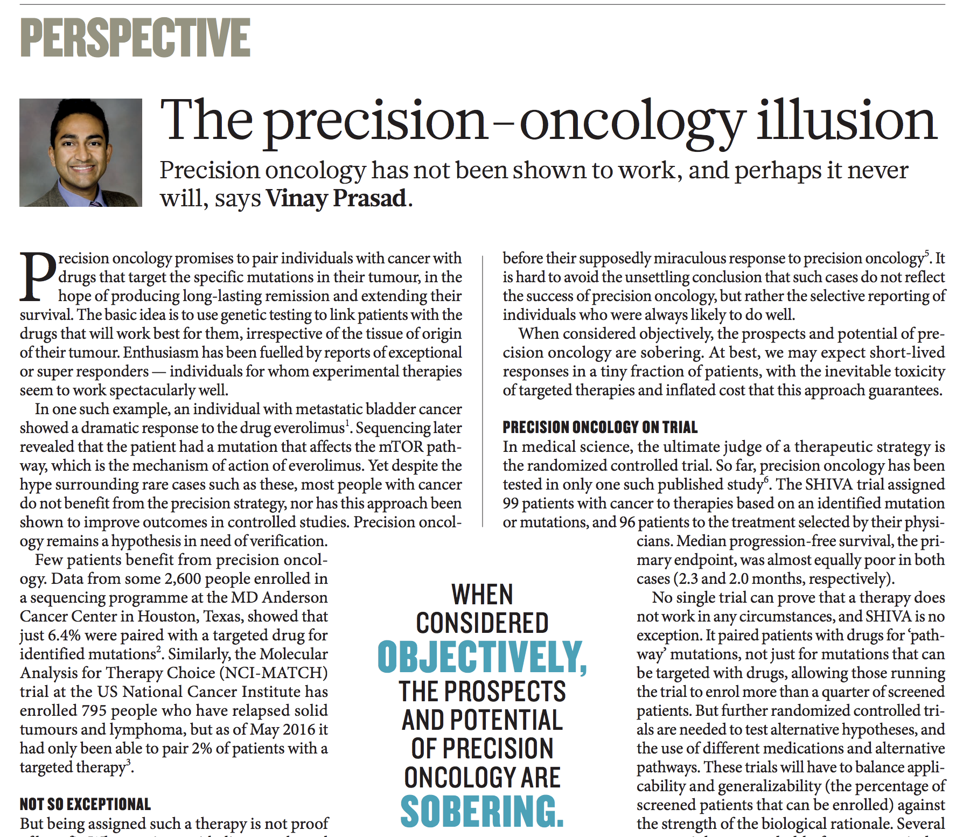

Slide 13
Precision and The Person
Precision Medicine
Personalized Medicine
The Premise,
The Promise and
The Hype!

Slide 14
Precision and The Person
? Point Mutations (HER2, EGFR, c-kit, ALK…etc)
? Oncogene addiction
Precision Medicine
Personalized Medicine
The Premise,
The Promise and
The Hype!
? Complexity
? Gene networks
? Epigenetics
? The Interactome
? Heterogeneity

Slide 15
Goals of PM?
NEAR TERM GOALS
Innovative clinical trial design
Use of combination therapies
Overcome drug resistance
LONGER TERM GOALS
Create cohorts of big data and share
Biological samples, diet/ lifestyle, linked to electronic health records*

Slide 16
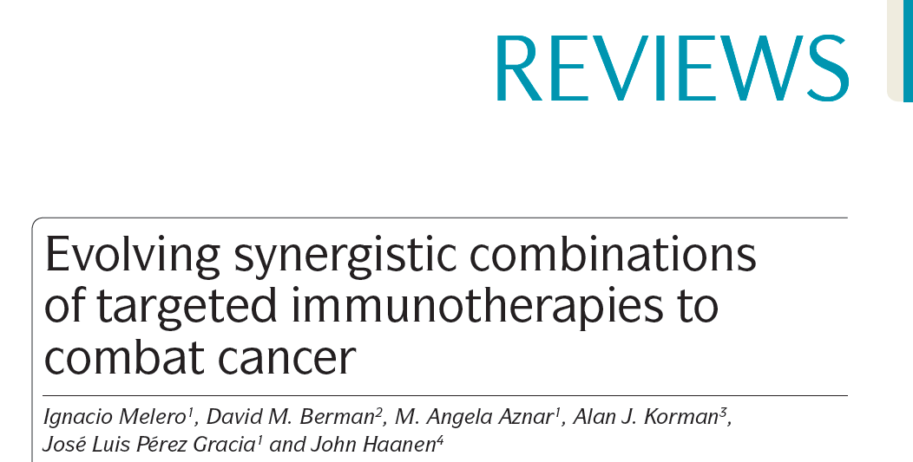

Slide 17
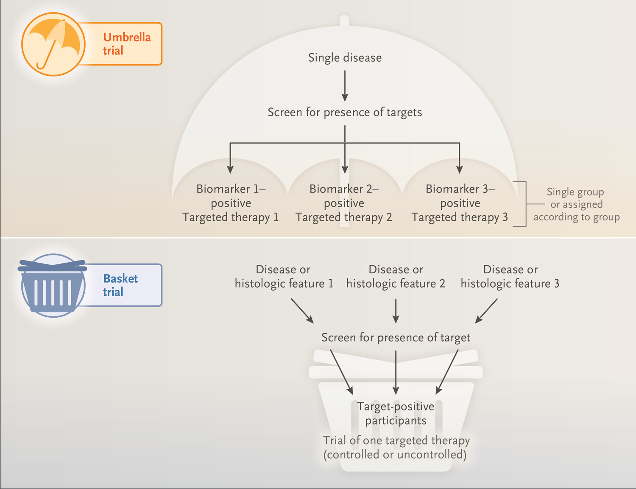
Woodcock J, LaVange LM. N Engl J Med 2017;377:62-70.
Umbrella Trial and Basket Trial
Notes:
Figure 1. Umbrella Trial and Basket Trial. An umbrella trial (top) evaluates various (often biomarker-defined) subgroups within a conventionally defined disease. Patients with the disease are screened for the presence of a biomarker or other characteristic and then assigned to a stratum on the basis of the results. Multiple drugs are studied in the various strata, and the design may be randomized or use external controls depending on the disease. A basket trial (bottom) involves multiple diseases or histologic features (i.e., in cancer). After participants are screened for the presence of a target, target-positive participants are entered into the trial; as a result, the trial may involve many different diseases or histologic features. A master protocol for a basket trial could contain multiple strata that test various biomarker–drug pairs. Statistical approaches are not depicted in this figure.

Slide 18
Standard protocol vs Common Control
CONTROL
DRUG A
VS
CONTROL
DRUG A
CONTROL
DRUG B
CONTROL
DRUG C
CONTROL
DRUG D
CONTROL
DRUG E

Slide 19
Master protocol: provides additional efficiencies (especially if harmonization of endpoints)
CONTROL
DRUG A
DRUG B
DRUG C
DRUG D
DRUG E

Slide 20
CONTROL
DRUG A
DRUG B
DRUG C
DRUG D
DRUG E
1M
1U
R
Notes:
Describe benefit of separating out 1st line methylated and unmethylated

Slide 21
CONTROL
DRUG A
DRUG B
DRUG C
DRUG D
DRUG E
1M
1U
R
SUBTYPES
Notes:
Sub types and signatures
All first line

Slide 22
CONTROL
DRUG A
DRUG B
DRUG C
DRUG D
DRUG E
1M
1U
R
SIGNATURES
Notes:
Sub types and signatures
All first line

Slide 23
CONTROL
DRUG A
DRUG B
DRUG C
DRUG D
DRUG E
1M
1M
1U
1U
R
R
SUBTYPES

Slide 24
CONTROL
DRUG A
DRUG B
DRUG C
DRUG D
DRUG E
1M
1M
1U
1U
R
R
SIGNATURES

Slide 25
CONTROL
DRUG A
DRUG B
DRUG C
DRUG D
DRUG E
1M
1M
1U
1U
R
R
SIGNATURES
Notes:
Signatures bundle different subtypes for the potential of borrowing power toward defining the broadest possible indications for which the treatment arm would have a benefit.

Slide 26
CONTROL
DRUG A
DRUG B
DRUG C
DRUG D
DRUG E
.20 .16 .16 .16 16 .16
STAGE 1
Fixed
Randomization
Adaptive
Randomization
STAGE 2
Fixed
Randomization

Slide 27
CONTROL
DRUG A
DRUG B
DRUG C
DRUG D
DRUG E
STAGE 1
Fixed
Randomization
1M
.20 .08 .12 .24 .16 .20
Adaptive
Randomization
Drug A
Drug B
Drug C
Drug D
Drug E
STAGE 2
Fixed
Randomization
Notes:
For each subtype calculate the posterior distribution of hazard ratio compared to control to be use for adaptive randomization

Slide 28
CONTROL
DRUG A
DRUG B
DRUG C
DRUG D
DRUG E
STAGE 1
Fixed
Randomization
R
Adaptive
Randomization
.20 .16 .00 .36 .08 .20
Drug A
Drug B
Drug C
Drug D
Drug E
STAGE 2
Fixed
Randomization
Notes:
Evaluate predictive probability for each signature, if predictive probability for each signature in a therapy is <25% then the enrollment stops and futility is reached
If predictive probability of any signature a in therapy has a predictive probability of >80%, that signature graduates to stage 2. all other subtypes not involved in that signature stop further enrollment
Signatures graduating to stage 2 have fixed randomization with the control arm of the same signature
After completion of enrollment in stage 2, if the probability of HR is <1 for greater than 98% of the posterior distribution of the HR, statistical success is claimed.

Slide 29
CONTROL
DRUG A
DRUG B
DRUG C
DRUG D
DRUG E
STAGE 1
Fixed
Randomization
X
Adaptive
Randomization
X
X
STAGE 2
Fixed
Randomization
Notes:
Evaluate predictive probability for each signature, if predictive probability for each signature in a therapy is <25% then the enrollment stops and futility is reached
If predictive probability of any signature a in therapy has a predictive probability of >80%, that signature graduates to stage 2. all other subtypes not involved in that signature stop further enrollment
Signatures graduating to stage 2 have fixed randomization with the control arm of the same signature
After completion of enrollment in stage 2, if the probability of HR is <1 for greater than 98% of the posterior distribution of the HR, statistical success is claimed.

