Slide 1
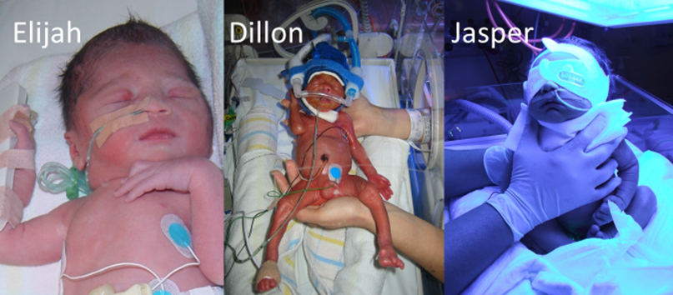

Prioritising Research –
A Consumer Perspective
Melinda Cruz
Founder, Miracle Babies Foundation
Mum to 3 miracles
^{www.miraclebabies.org.au}

Slide 2

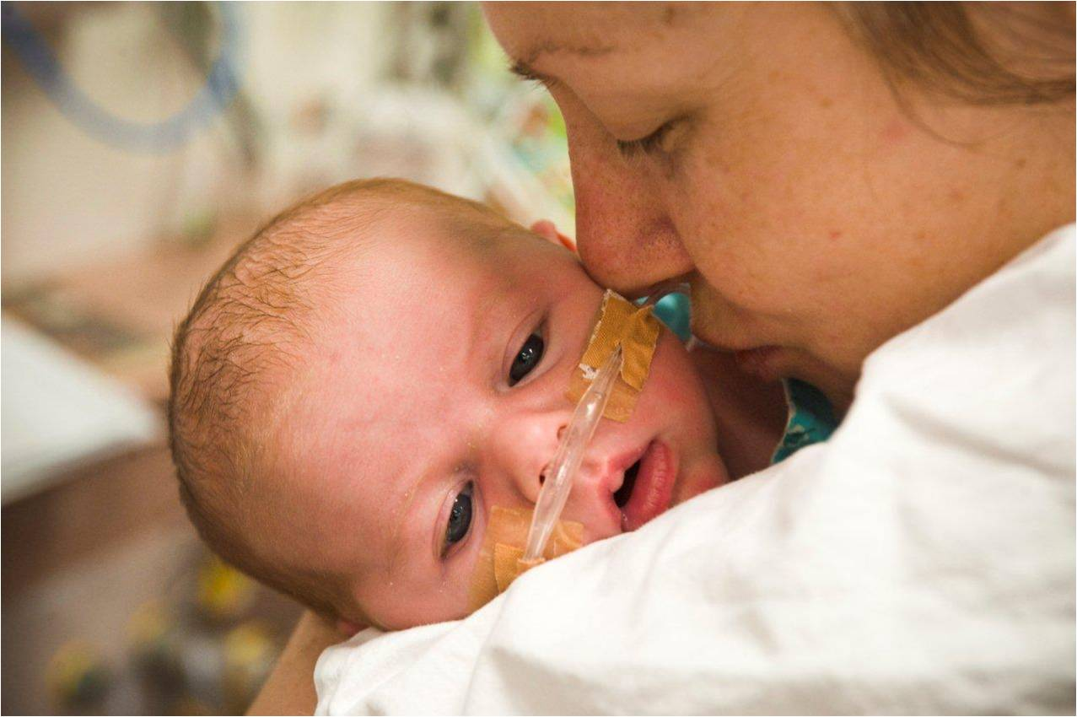
“Better healthier outcomes for newborns and their families challenged by prematurity and sickness”
We are a consumer based organisation
working with and for the families of premature and sick babies and
the health professionals
who care for them

Slide 3
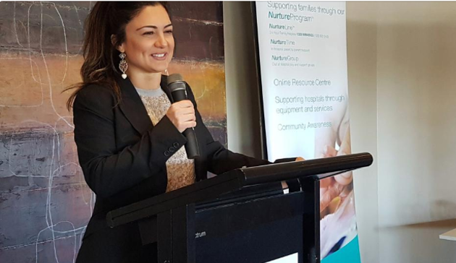
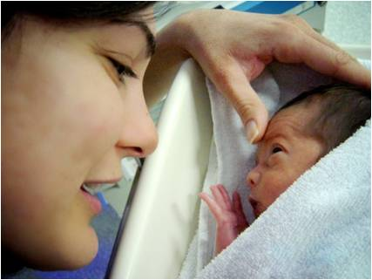
2007

Slide 4
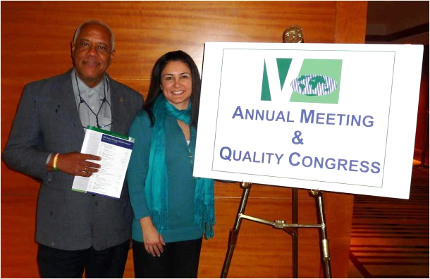
2012

Slide 5
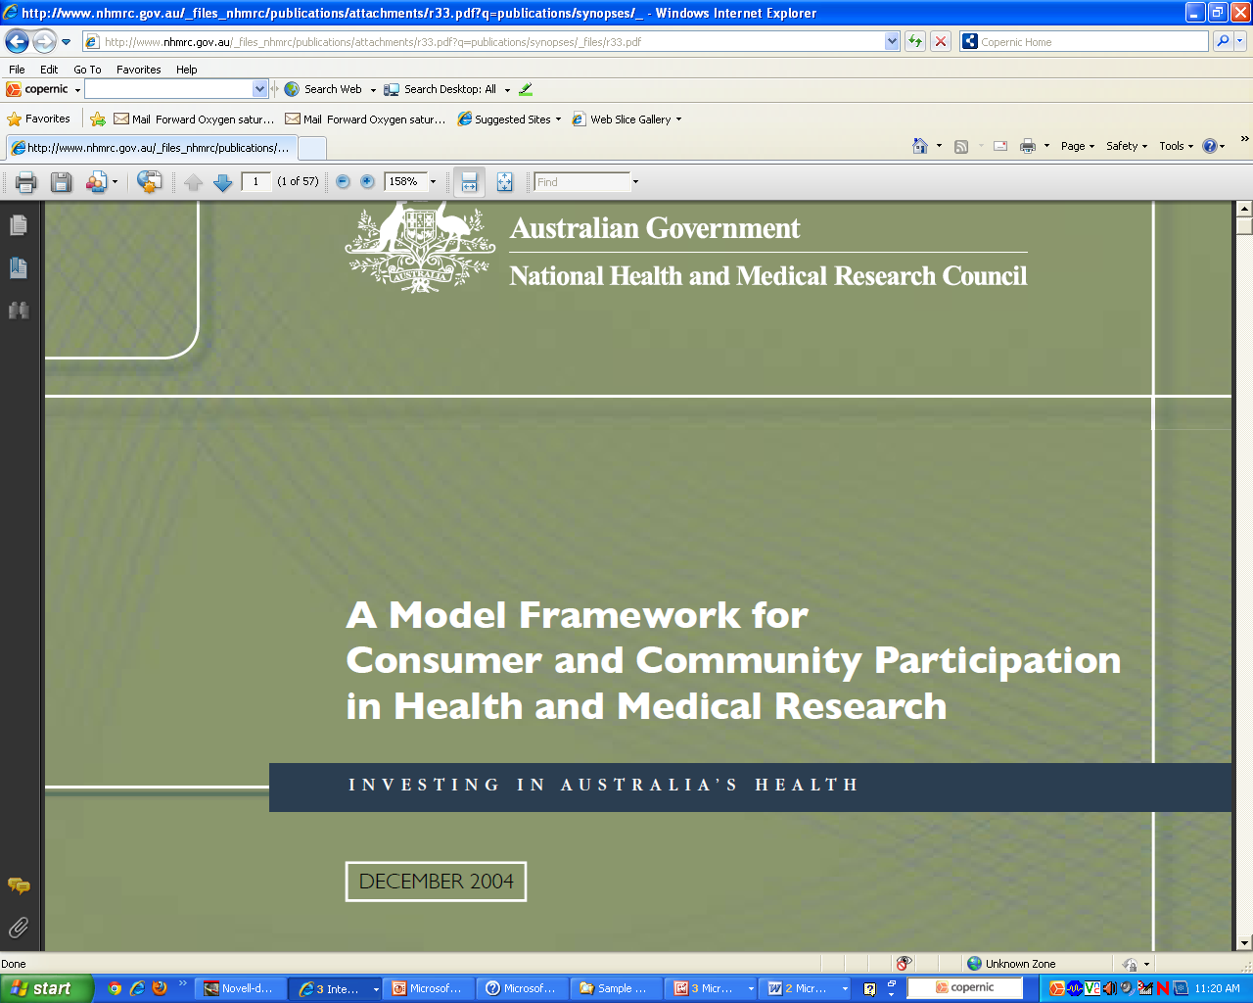
2012
In 2004, encouraged the ‘appointment of consumers as decision-makers in research..’
page 8

Slide 6
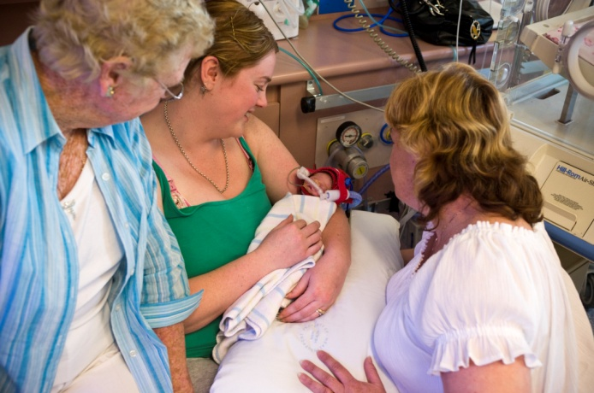
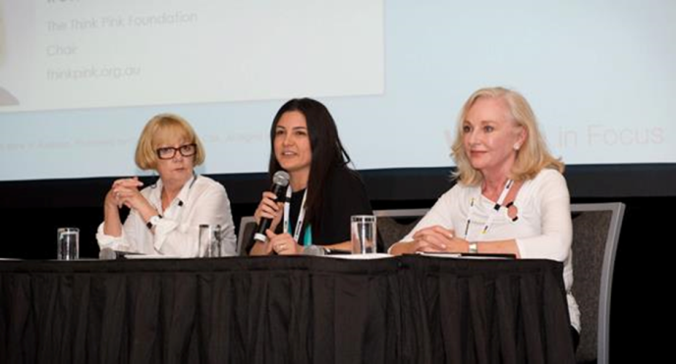
Two types of consumers
The ones who use the service (patients)
The ones who engage to improve the service
Notes:
I think one of the thing that become apparent to me, particularly when talking clinical trials, is that there are 2 types of consumers.
The ones we invite to participate in trials (the patients) and the ones we engage in the design or on the outset of trials (the consumer)
And these 2 really intertwine. One leads to the other, which leads back to the other. If we do this well, we’ll do that one well and if we do that well, we’ll do that one well.

Slide 7

What’s so great about having us in health?
Here is a group of people who have gone through their own trauma
…. and instead of saying that’s it,
they are putting their hand up and saying
“How can I use what I went
through to make it easier and
better for the next person?”
“How can I make what I went through matter?”
“How can I give back?”
Notes:
So what is so great about consumers in health???
This is my point of view…but part of the reason we are unique is that we bring the emotional viewpoint.
Let me tell you ….
It…. SUCKED having premature babies …. not 1, 2, but 3 times when I did everything right.
It was horrible watching my dad battle bowel cancer, it is so upsetting to see my father in law basically exist after the effects of a terrible stroke, it was devastating to lose my cousin, when we were both 18 to leukeumia.
Really bad shitty traumatic stuff that we don’t ask for and instead of saying well that’s it then, you know my boys are out of hospital and doing well or my dad recovered from his surgery, my father in law just now needs constant care or Carmel died,
We are putting our hand up …and saying…… how can I use what I went through to make it easier for the next person, the next baby, the next family?
I think it is an amazing part of the human function, an incredible quality to want to give back to others, likely to be people you’ll never met and say I want to change the experience for you.
And it is exactly what happened to us.
…. and instead of saying that’s it then, they are putting their hand up and saying “how can I use what I went through to make it easier for the next person?”

Slide 8
Benefits Consumers Can Offer
The personal perspective of the experience
Help set joint priorities
Assist in design of information material
Endorse the research or trial - and recruitment to it
Skills that complement those of clinicians and researcher, e.g.
  education and IT
  law, business, marketing and graphic design
  public speaking and advocacy
Help in dissemination of results
Passion
Notes:
Benefits Parents Can Offer
The personal perspective of the NICU experience
Help set joint priorities, in agreement with researchers and clinicians (as in the James Lind Alliance, UK NIHR)
Design information material for other parents and researchers
Endorse the research or trial - and recruitment to it
Skills that complement those of clinicians, e.g.
education and information technology
law, business, marketing and graphic design
public speaking and advocacy
Passion e.g as Parent Advocates and Consumer Groups

Slide 9
What do we want?
We want researchers to be receptive of our involvement
We want to know that our contributions are meaningful and valuable
We want to know that we are not token
Notes:
What do we want? Here are the leading themes.
We want to be educated enough to make contributions that are meaningful and valuable. NOT token.
Systematic approach to finding, engaging and upskilling consumers
Training course → National Register of willing and, educated consumers for researchers to find and engage with.
We want to assist in priority setting and to help ensure that research changes practice and contributes to a better world otherwise why do it?
Have a say in where the funding should go
Use us for our experience, our skills and our contacts
Researchers to be receptive of our involvement

Slide 10
Practical Points
Invite more than one consumer to join a research or trial management committee, to support each other.
Hold meetings at times when consumers can attend
Reimbursement for time, travel, parking, childcare
Offer some basic training/ education for consumers about trials & avoid - or translate -‘foreign’ professional language
Make consumers feel welcome and free to ask about what they don’t understand
Notes:
Practical Points
Invite more than one parent to join a research or trial management committee, to support each other.
Hold meetings at times when parents can attend
Reimbursement for travel, car park, childcare
Offer training/ education for parents about trials
Avoid - or translate -‘foreign’ professional language.
Make parents feel welcome and free to ask about what they don’t understand.

Slide 11
Researcher Feedback
“I’m ashamed to admit that the first time I think about consumers in the entire process is at the end when I need their consent and not before”
Notes:
At a workshop being run by Anne McKenzie that I was invited to speak at
Researcher
“I’m ashamed to admit that the first time I think about consumers in the entire process is at the end when I need their consent and not before”
Anne McKenzie stated this week, that they felt they were training the wrong people and have developed an amazing training program for researchers. I don’t think it is the wrong people and its both sides of the same coin and both are equally important.

Slide 12
Power of network
Notes:
We use social media a lot – here are some examples and ways we can help you access your audience.

Slide 13
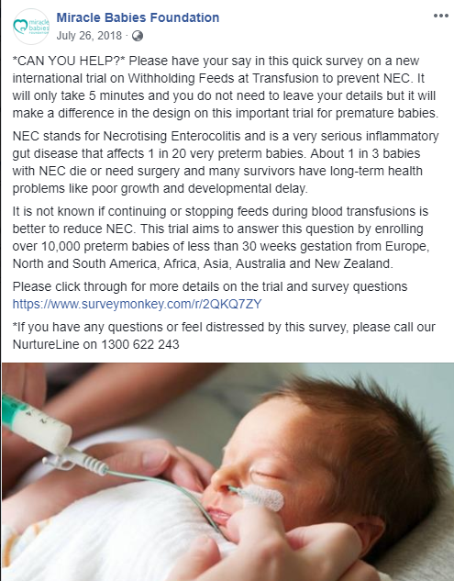
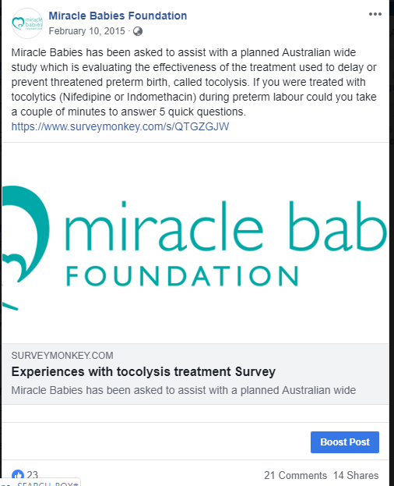
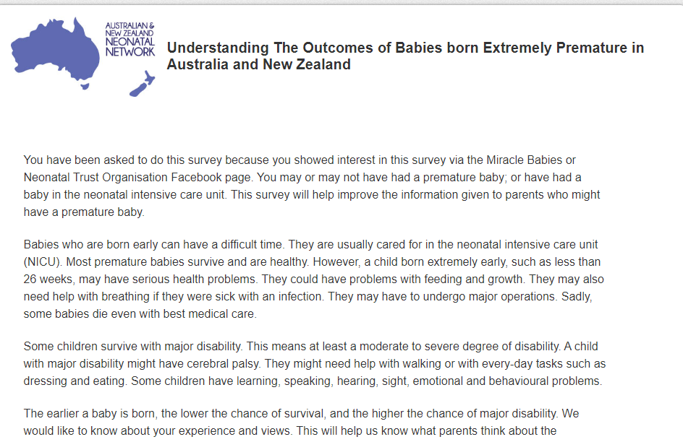
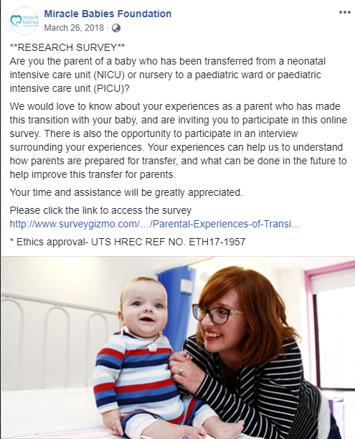
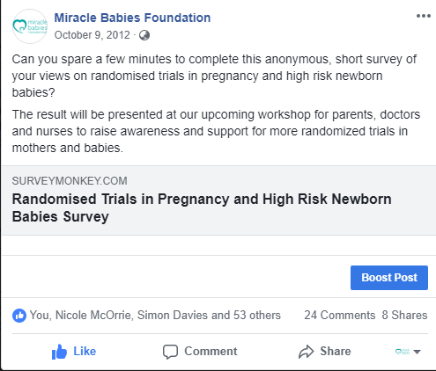
Platform to ask parents

Slide 14
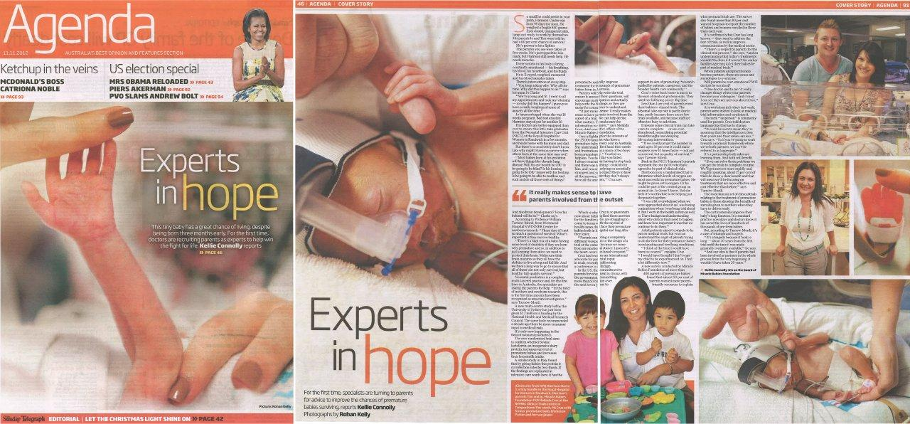
The Sunday Telegraph

Slide 15

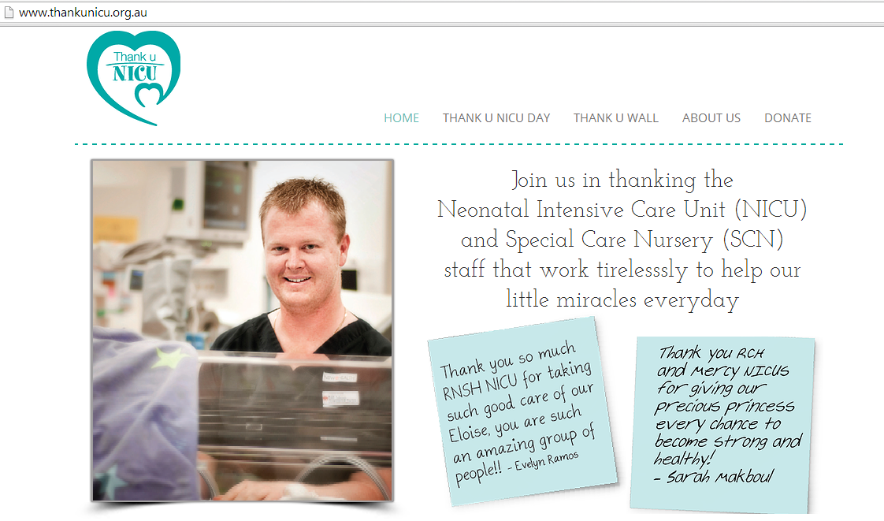

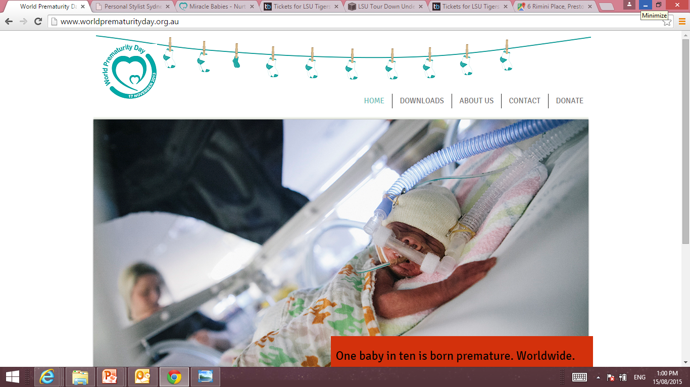

National Campaigns

Slide 16
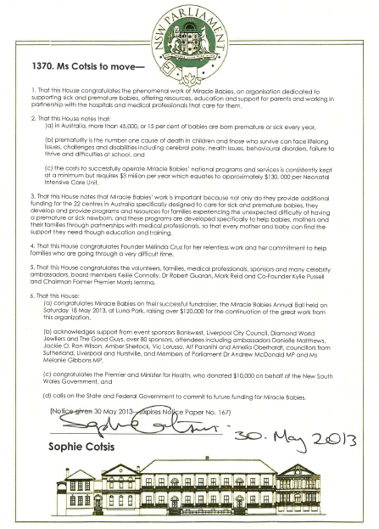
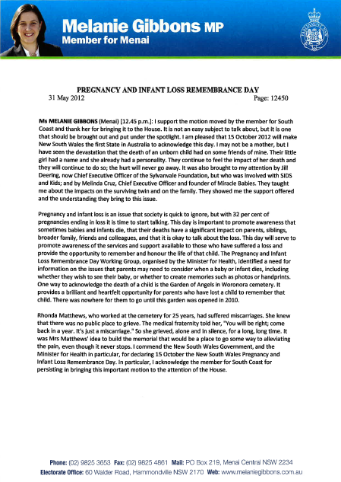
Parliamentary Speeches

Slide 17
Since 2012
Appointed Honorary Research Associate, NHMRC Clinical Trials Centre
First parent to be an Associate Investigator on a NHMRC neonatal trial; LIFT. Number of trials since.
Joined PSANZ Consumer Advisory Panel (CAP) and Clinical Trials executive committee
Joined the NHMRC Clinical Trials Ready Development Committee
Contributed to the dissemination of the results of BOOST II and APTS trials
Lead the consumer contribution to the Australian arm of the FiCare Trial.
To date, co-authored 9 publications.
Contributor to THRIVE Global with 5 published articles to date
Assisted in obtaining a waiver of consent for the TORPIDO 30/60 Trial

Slide 18
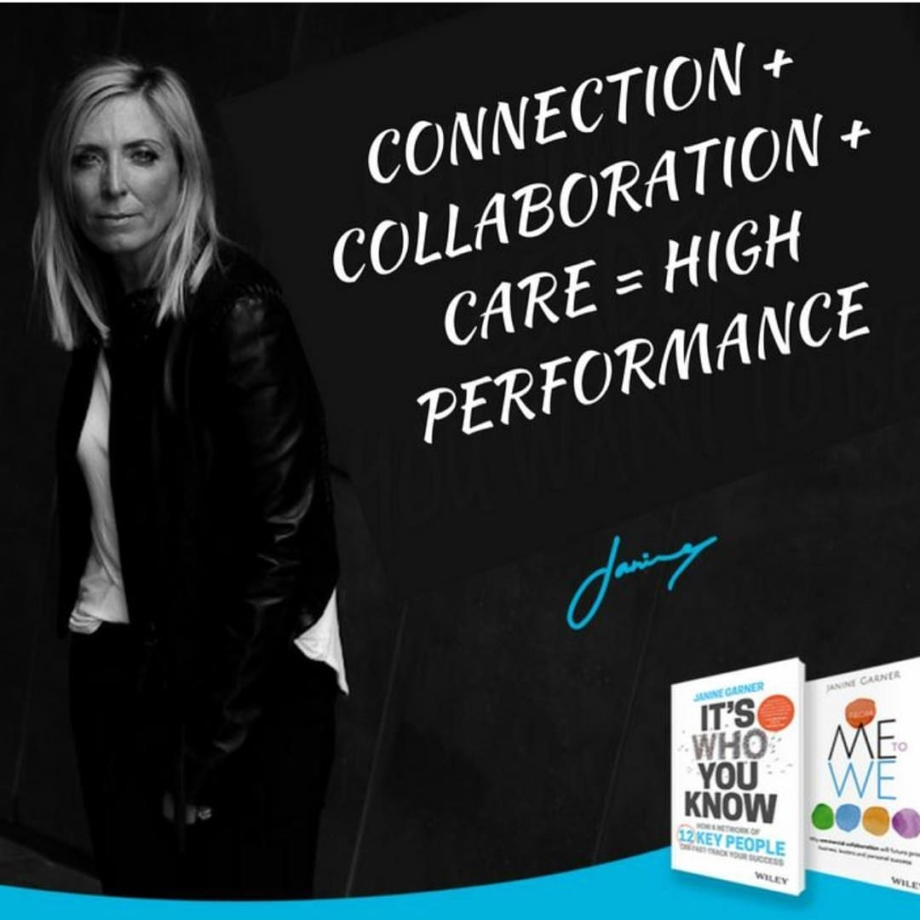

Slide 20
Helping consumers say yes
Survey conducted by Miracle Babies Foundation of more than 400 parents of premature babies found that almost 90 per cent of parents wanted more parent-friendly resources to explain what perinatal trials are.
The survey also found more than 80 per cent wanted hospitals to report the number of babies and women enrolled in these trials each year.
Notes:
We conducted an online survey in the lead up to the conference and found that from 400 responses:
almost 90 per cent of parents wanted more parent-friendly resources to explain what perinatal trials are.
The survey also found more than 80 per cent wanted hospitals to report the number of babies and women enrolled in these trials each year.

Slide 21
What do consumers need to feel confident of a study
Transparency
Confidence
Education
Supported and Heard
As best as possible, remove any fear

Slide 22
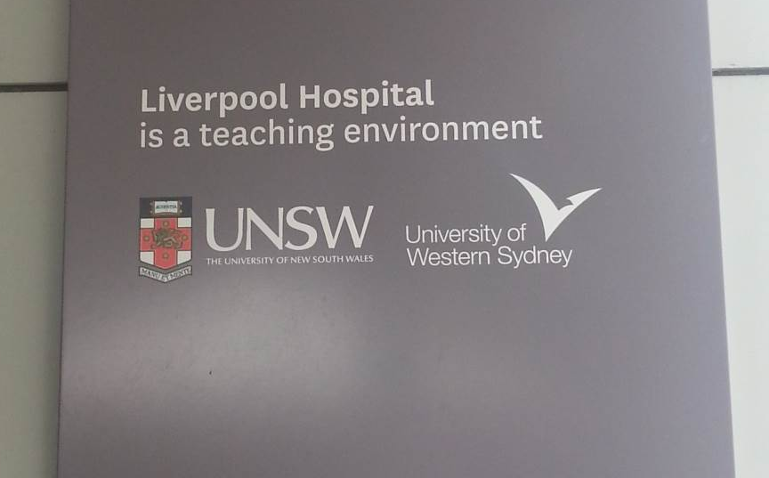
Culture Change
Liverpool Hospital
is a teaching and research
environment
Notes:
I really believe and listening today that what we need is a complete shift in mindset.
Across all areas – clinicians , consumers and the general public.
This is a major road block. We need more awareness in general about the importance of trials. I don’t’ understand why we don’t.
Think back to the at school comment.
We should all know this.
You know, I don’t smoke, never have, never will. But I know of the QUIT campaign and I don’t need it. If you sat with me at dinner last night, you would learn that I don’t drink either but I know of the effects of say drinking and driving and it doesn’t directly apply to me. Yet at some stage I am, and do and have just like each one of us use the health system …. So how come I don’t know about trials?????????
My husband is a GM at Syd Trains and he was brought is as a change agent to change culture. They do it elsewhere …. Not impossible here and I think ACTA will play a vital part of that.
So just quickly a couple of this when talking awareness. At the entrance to Liverpool Hospital is this sign.
And what is the ideal goal. Could it be asking this question?
The is you betcha. At one of our workshops……
The sad thing was, the hospital never asked them and they were eligible but he was aware and influenced his partner .. Roll on effect.
Why aren’t there posters on the walls about whats going on?

Slide 23
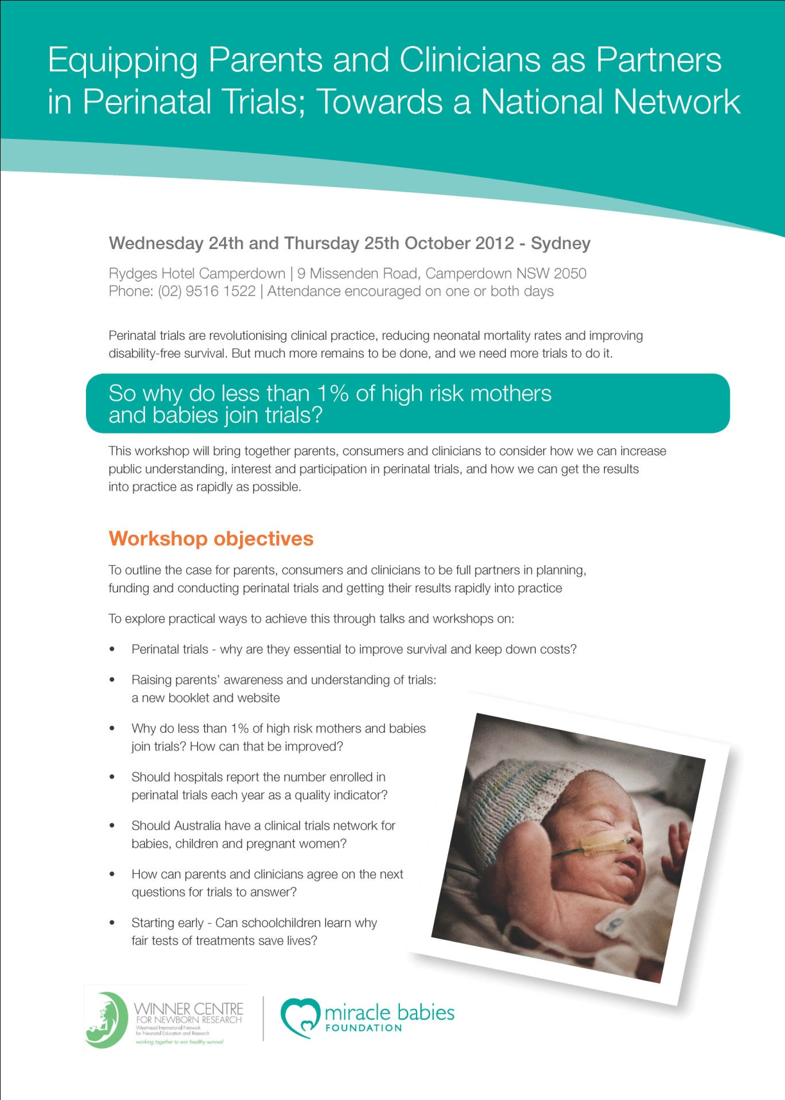
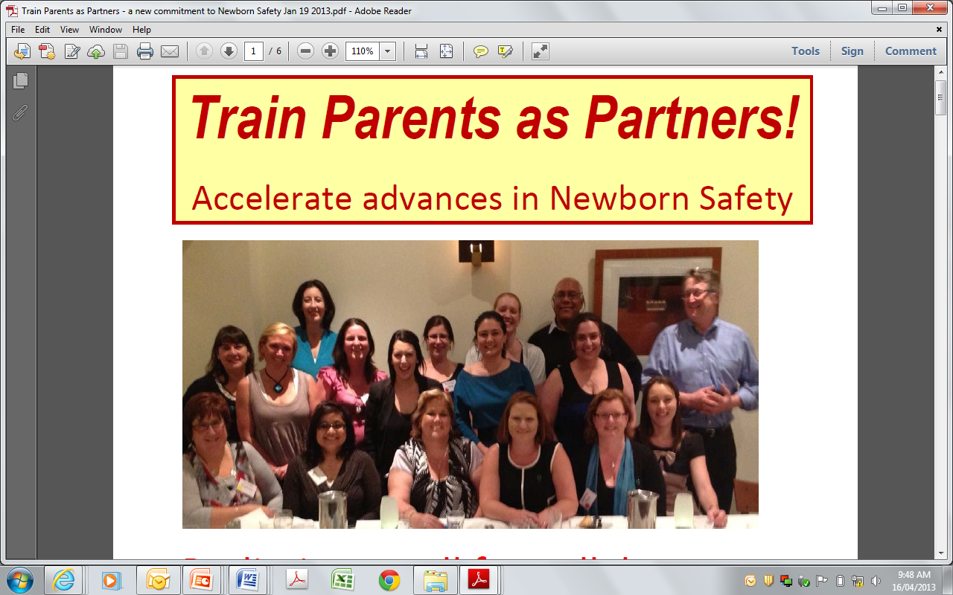
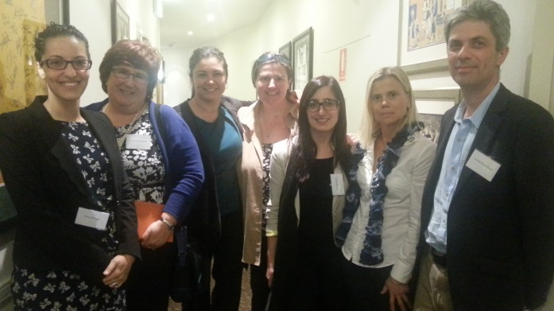
Notes:
To address this we have held four workshops to explore feasible strategies to equip consumers and clinicians as effective partners.
One or two day workshops were held in Sydney in 2012, 2013, 2014 and 2015;
10-50% of attendees were parents or other non-health professionals. Common themes and goals were identified.
One of the most notable thing was the willingness of parents to want to help and ‘give back’ hear that a lot but not knowing how.

Slide 24
When to inform parents?
When the baby is delivered?
When the mother is on bedrest?
Antenatal classes?
When you book into the hospital?
Why isn’t it taught at school?
Notes:
We also discussed when to inform parents.

Slide 25
What to aim for …
Can we change community awareness and culture and reach a point where one of the questions patients routinely ask is
“are there any trials I can join?”
Notes:
I really believe and listening today that what we need is a complete shift in mindset.
Across all areas – clinicians , consumers and the general public.
This is a major road block. We need more awareness in general about the importance of trials. I don’t’ understand why we don’t.
Think back to the at school comment.
We should all know this.
You know, I don’t smoke, never have, never will. But I know of the QUIT campaign and I don’t need it. If you sat with me at dinner last night, you would learn that I don’t drink either but I know of the effects of say drinking and driving and it doesn’t directly apply to me. Yet at some stage I am, and do and have just like each one of us use the health system …. So how come I don’t know about trials?????????
My husband is a GM at Syd Trains and he was brought is as a change agent to change culture. They do it elsewhere …. Not impossible here and I think ACTA will play a vital part of that.
So just quickly a couple of this when talking awareness. At the entrance to Liverpool Hospital is this sign.
And what is the ideal goal. Could it be asking this question?
The is you betcha. At one of our workshops……
The sad thing was, the hospital never asked them and they were eligible but he was aware and influenced his partner .. Roll on effect.
Why aren’t there posters on the walls about whats going on?

Slide 26
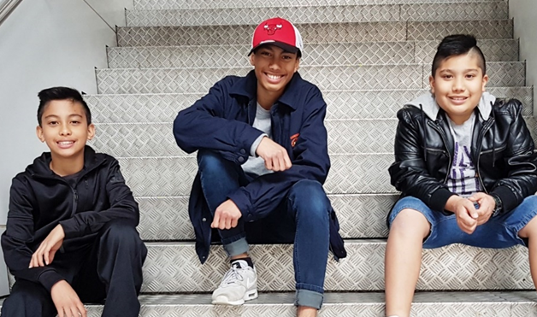
my boys
Notes:
And it needs to happen….. For 3 bigger reasons.

