Slide 1

Data Sharing in Clinical Trials
Defining what we know
Honoring those at risk
Sustaining the field
Jeffrey M. Drazen, M.D.
Editor-in-Chief, New England Journal of Medicine
Distinguished Parker B. Francis Professor of Medicine, Harvard Medical School

Slide 2






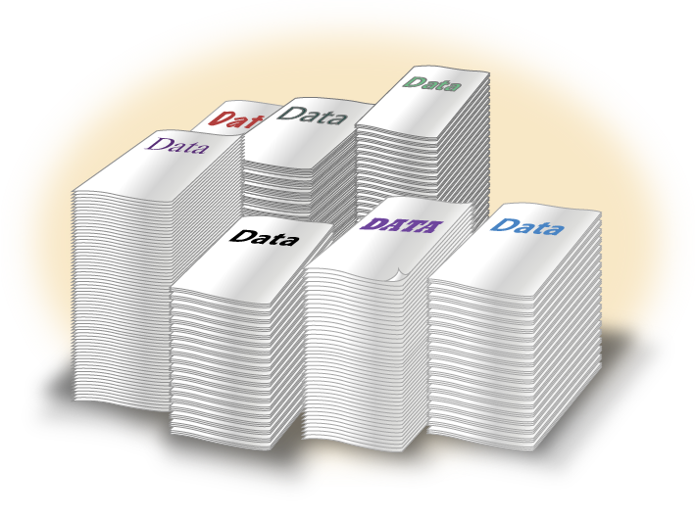
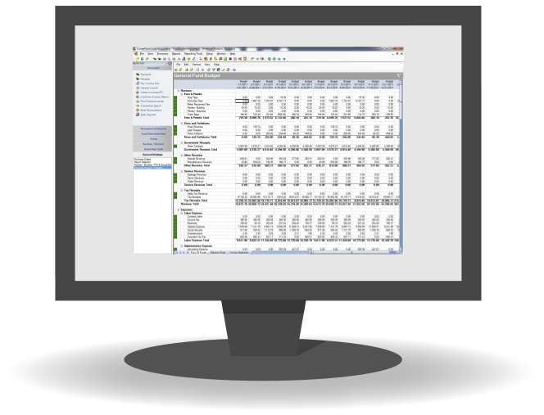


Clinical Question
Participants
Randomization
Clean Data
Data Analysis

Slide 3







Patients
ANY JOURNAL
OTHER JOURNAL
Trialists
Clean Data
Data Scientists

Slide 4
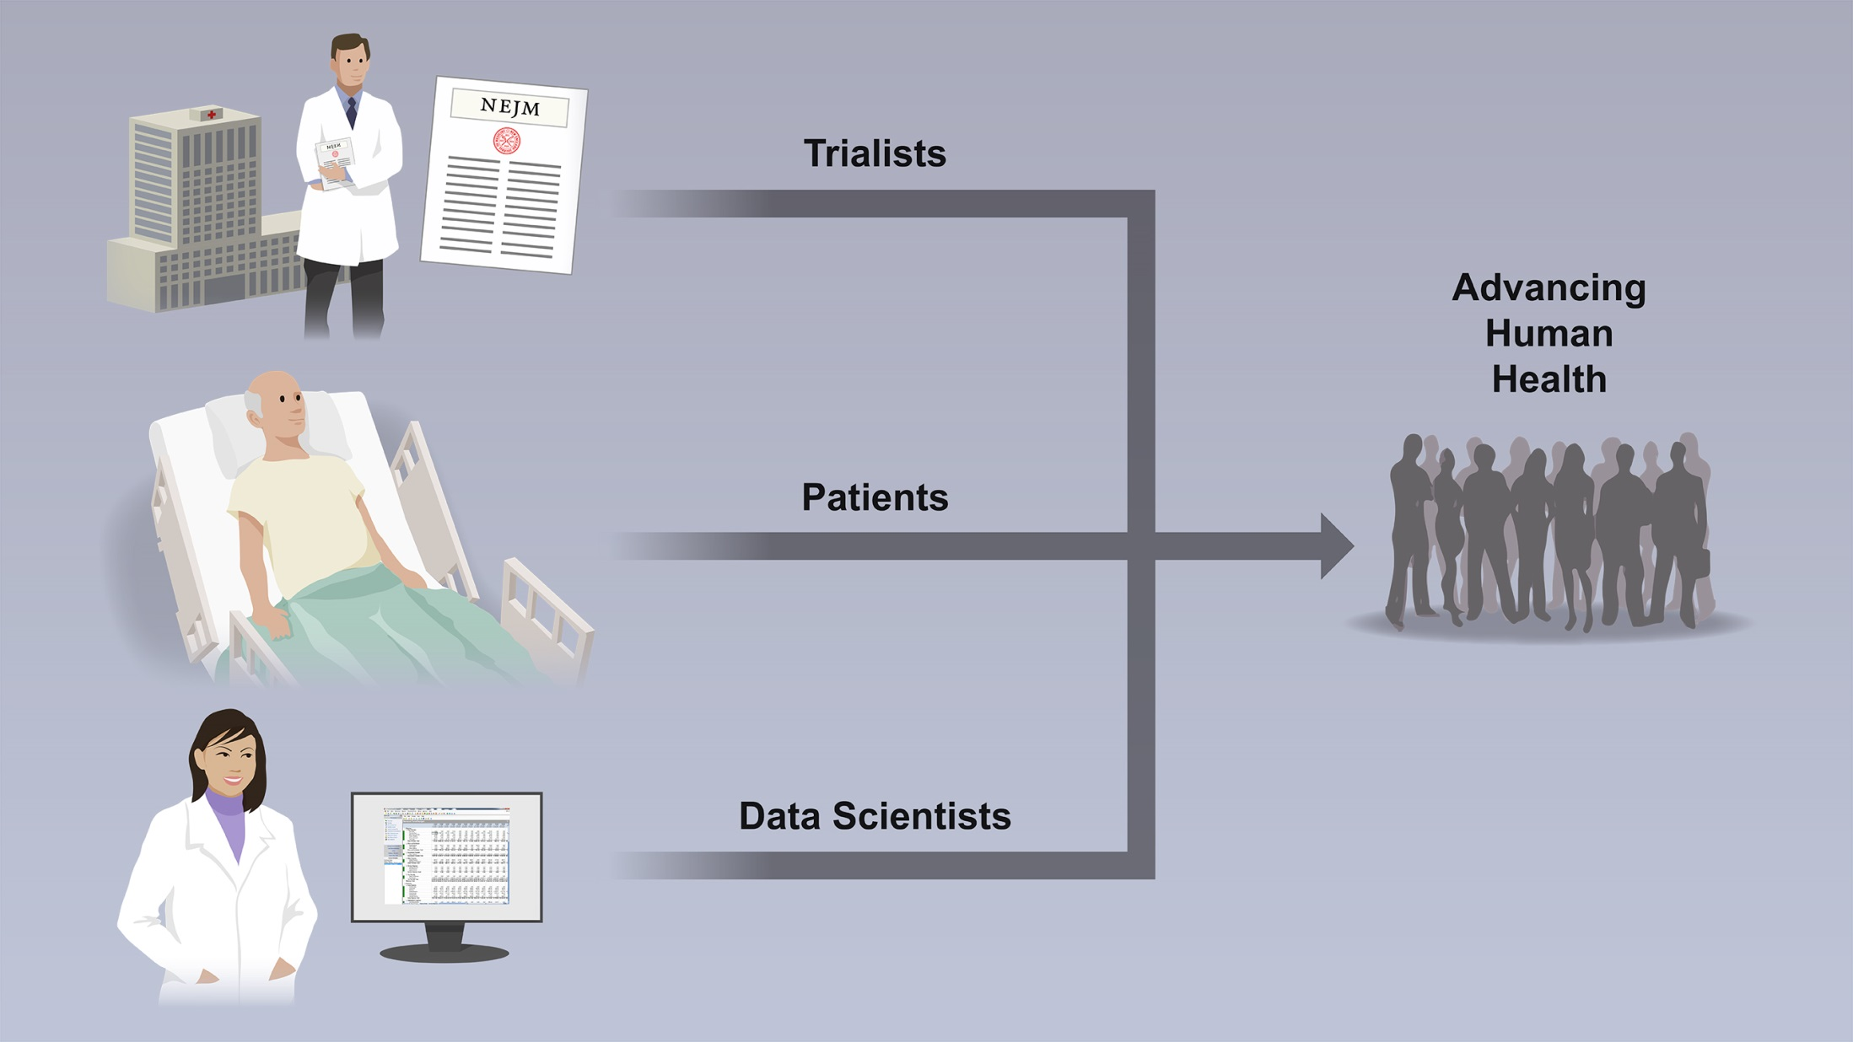
Trialist Concerns
Major Trial Questions
Time Investment
Rewards
Patient Concerns
Privacy
Want Data to be Widely but
Responsibly Used
Data Scientists Concerns
Transparency
Data Not Public
New Ideas
Notes:
Trialists Concerns
Major questions addressed by the trial
Time invested versus time for data use
Little reward for future trialists
Patient Concerns
Privacy
Their data not widely shared
Their data not used responsibly
Data Scientists Concerns
Transparency
Publicly supported data not public
New ideas not sought

Slide 5
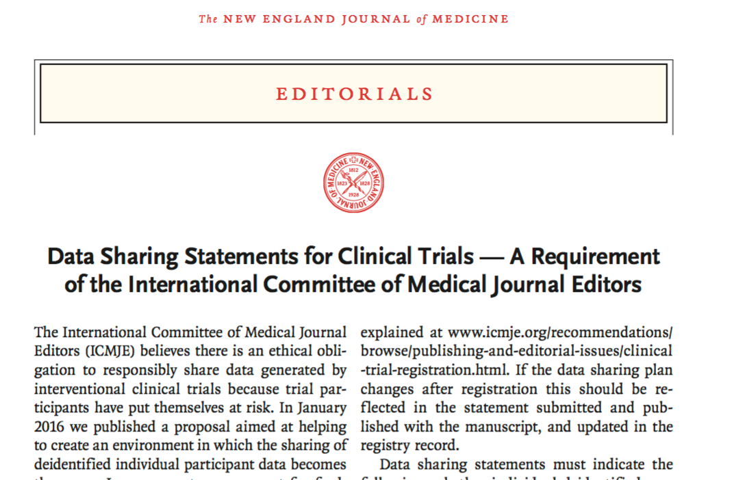
June 8, 2017

Slide 6
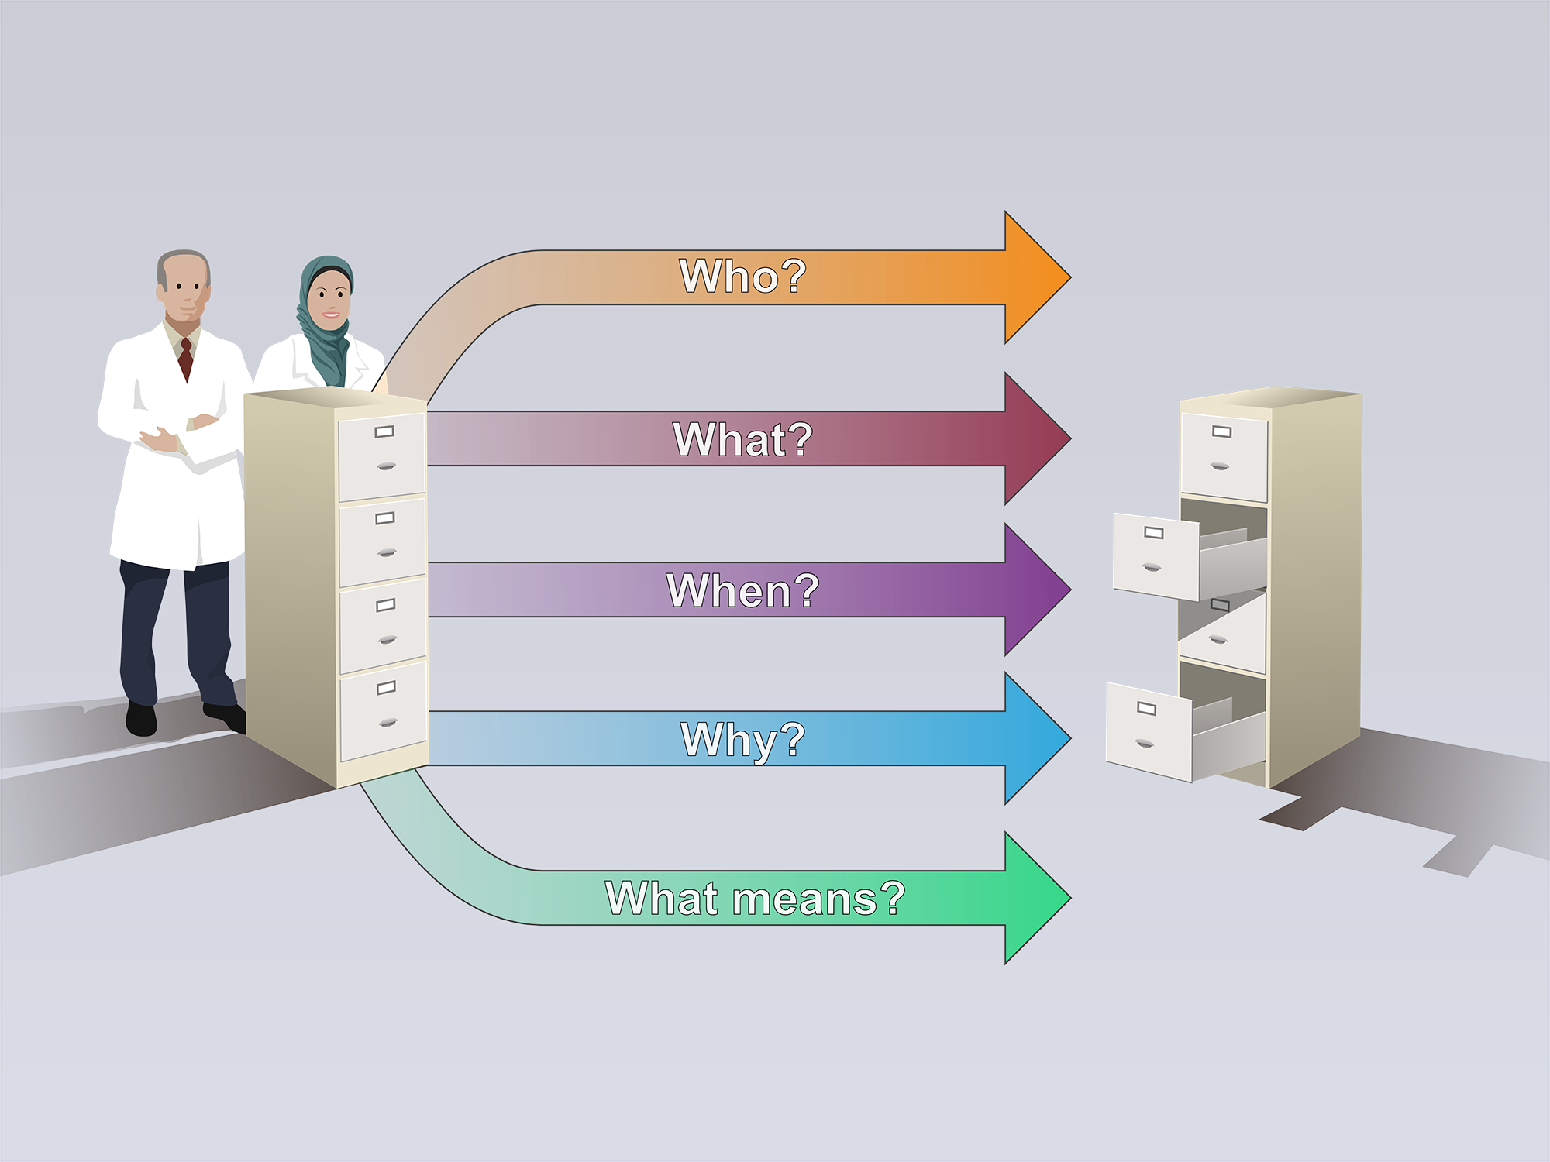
Public Data Sharing Statement
July 1
2018
Clinical Trialists
Data
Warehouse

Slide 7
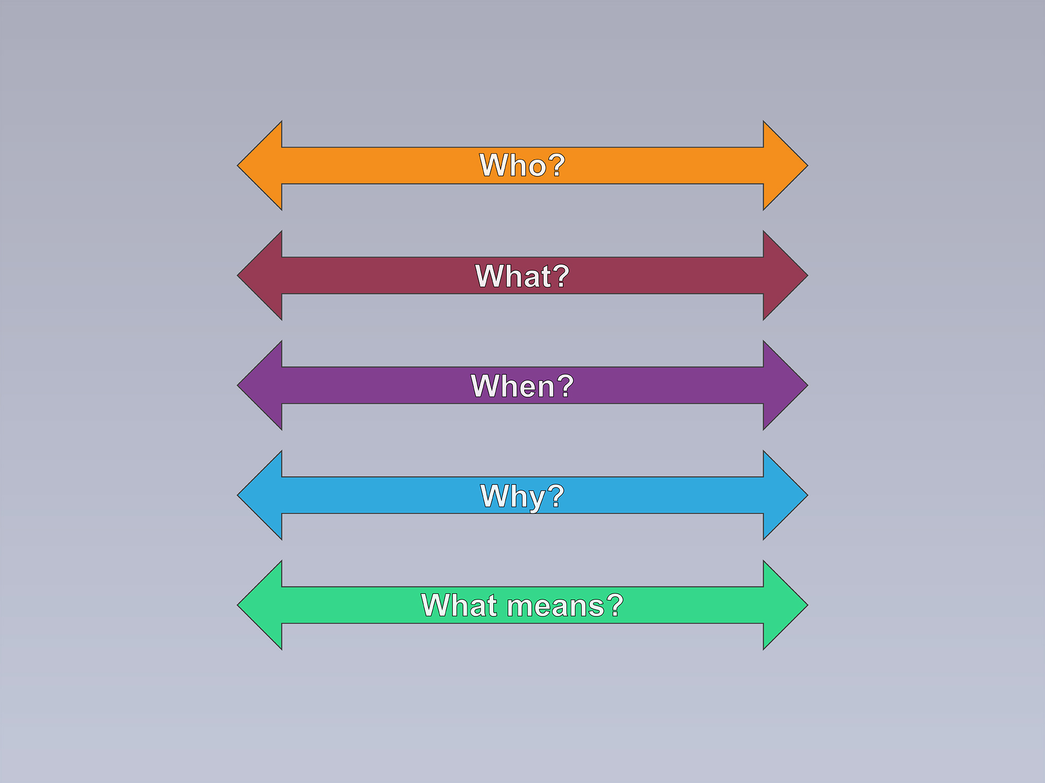
Examples of Public Data Sharing Statements
Anyone
All
Immediately
Any purpose
Public
Authorized
From article
Pre-specified
Meta-analysis
Designated warehouse
No one
No data
Never
Not applicable
No access
Open access
Controlled access
No access

Slide 8
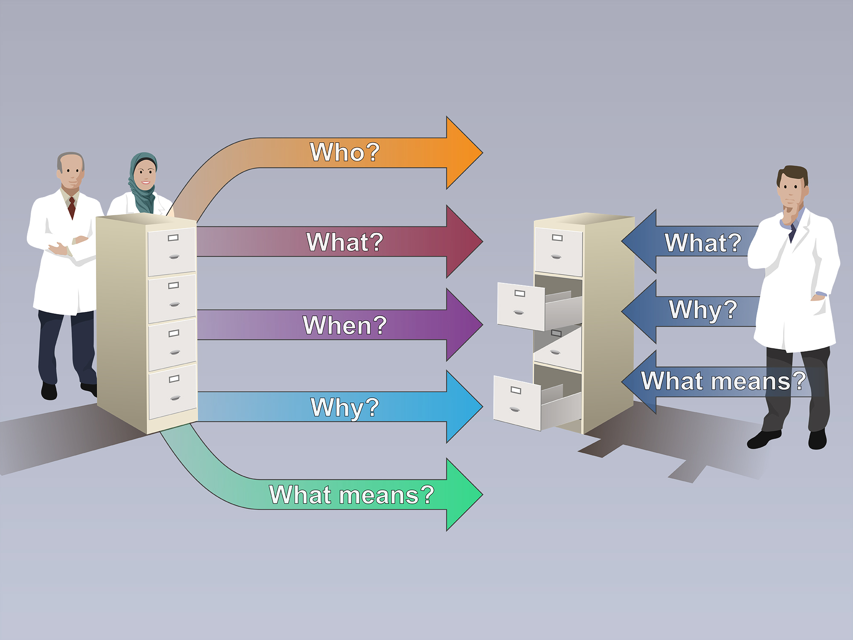
Public Data Use Statement
Data
Warehouse
Clinical Trialists
Data
Analyst

Slide 9


DATA WAREHOUSE
FRONT OFFICE
Open to the public

Slide 10
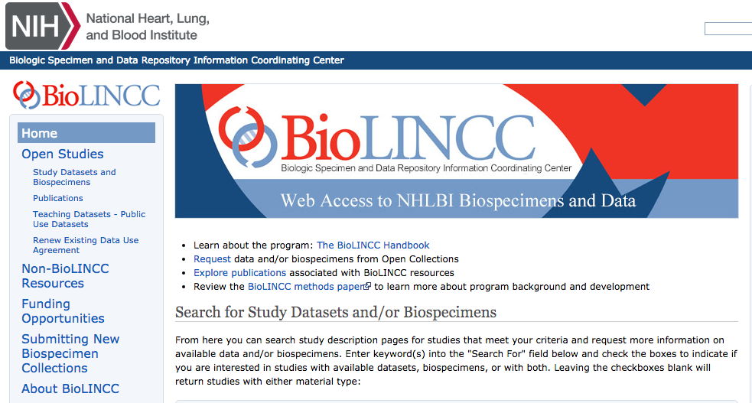








National Database for Clinical Trials Related to Mental Illness (NDCT)
DATA WAREHOUSE
FRONT OFFICE
Notes:
SOAR - Duke Clinical Research Institute
YODA – Yale
ACCESS – CVS
Project Data Sphere- Project Data Sphere, LLC (PDS), an independent, not-for-profit initiative of the CEO Roundtable on Cancer's Life Sciences Consortium (LSC), operates the Project Data Sphere platform, a free digital library-laboratory that provides one place where the research community can broadly share, integrate and analyze historical, patient-level data from academic and industry phase III cancer clinical trials.

Slide 11
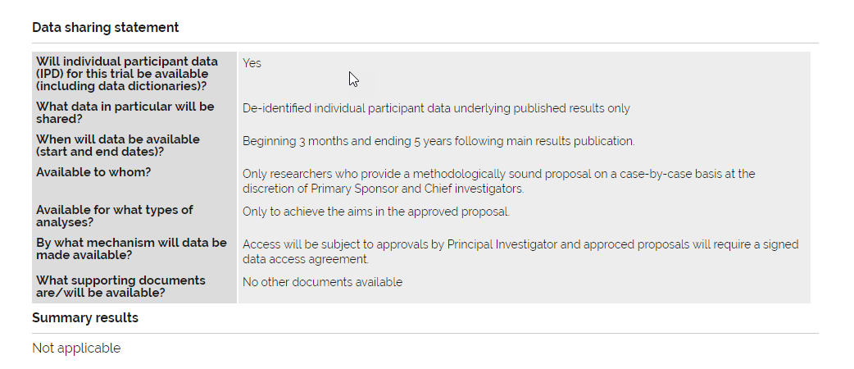
ANZCTR

Slide 12
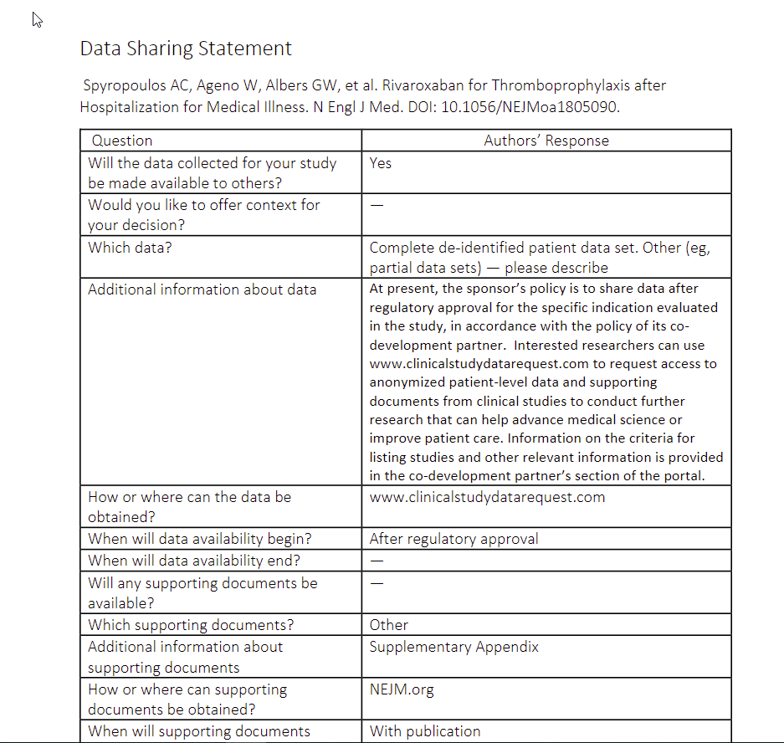
Notes:
The data sharing statements are generally a single page; this is the top part of one example. Article information appears at the top of the page.
ICMJE journals are handling in various ways (e.g., BMJ has tiers of articles with different data sharing requirements for each
and has a list of standard statements for authors to choose from, and they can be customized).
Approaches may be evolving as we all learn what works best.

Slide 13
Submitted
Through 2/15/19
Notes:
These data represent all submitted articles with data sharing statements through the end of 2018.
Yes = 588
No = 399
Not a clinical trial = 1263
Paper originally submitted before July 1 = 12
No response = 62

Slide 14
Published since July 1, 2018

Slide 15
As of January 10, 2019
Will share data? | Response at Acceptance | Response after Proof | Change
No | 26 | 15 | -11
Yes | 23 | 35 | +12
Not a clinical trial | 4 | 4 | 0
Submitted before 7/1/18 | 8 | 7 | -1
Notes:
This table shows a comparison between authors’ data sharing statements at acceptance and their statements after they’ve seen them and reconsidered at the proof stage.
Jeff can probably tell us about any next steps being considered by the ICMJE.

Slide 16


