Slide 1

Randomized Controlled Trial’s
in a self-improving health system
PROFESSOR JOHN ZALCBERG
Chair, ACTA
1 March 2019
30/30 Horizons in Health Care

Slide 2
Self-improving Health System
Fundamental principles
High quality health care is critical to patients and saves money.
High quality care (value-based health care) is evidence-based
Best evidence is derived from randomized clinical trials (RCTs)

Slide 3
Idealized model of a self-improving health system

Slide 4
The role of quality registries
– detection of unwarranted variation

Slide 5
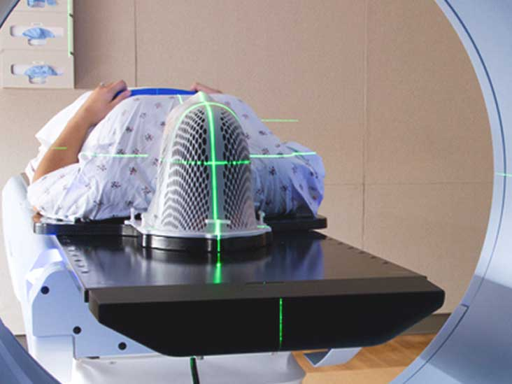
Why is there unwarranted variation?
Differences in supply and accessibility of services
Evidence doesn’t exist, or clinicians don’t know about it
Evidence is not accepted
  weak evidence, clinicians can’t see how it applies to their practice or ??
Personal preferences of clinicians
Other incentives (e.g. financial) for certain practices to continue/start/stop

Slide 6
Why is there unwarranted variation?
Differences in supply and accessibility of services
Evidence doesn’t exist, or clinicians don’t know about it
  evidence overload?
Evidence is not accepted
  weak evidence, clinicians can’t see how it applies to their practice or ??
Personal preferences of clinicians
Other incentives (e.g. financial) for certain practices to continue/start/stop

Slide 7
Current Colorectal Cancer Guidelines
Current Australian Colorectal Cancer Guidelines
Grade of Recommendation | Description | Levels of Evidence
A | Body of evidence can be trusted to guide practice | 1
B | Body of evidence can be trusted to guide practice in most situations | 1
C | Body of evidence provides some support for recommendation(s) but care should be taken in its application | 16
D | Body of evidence is weak and recommendation must be applied with caution | 17
Consensus |  | 16

Slide 8
The role of RCTs is to test interventions to prove or disprove an hypothesis

Slide 9
Clinical Trials vs Registries;
both contribute to the self-improving health system
Clinical trial | Registry
Investigational – hypothesis testing | Observational
Measures the efficacy of a treatment in a carefully selected patient cohort | Measures effectiveness of treatment in the population captured by the registry
Resourced for data collection | Often not resourced for data collection
Finite data collection period | Indefinite data collection period
Collect large amount of data | Collect minimal amount of data
Level II evidence | Level III evidence

Slide 10
Clinical Quality Registries vs Clinical Trials
Attributes | Clinical trial | Registry
Coverage | Usually small and unrepresentative of general population | Whole population
Purpose | Identifying what care should be delivered | Measuring whether good care is being delivered and impact on health outcomes (quality of life, survival, recurrence, cost)

Slide 11
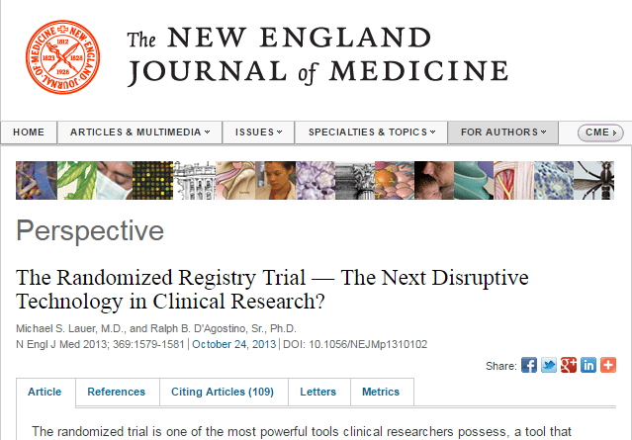
Improving Registries
Embedding clinical trials WITHIN registries – trials in real world populations

Slide 12
Do RCTs lead to improved outcomes in the population at large?
Within trial population receiving new therapy
Within control groups within randomized trials
Within centres that are research active?

Slide 13
Randomized Clinical trials lead to improved outcomes
Within trial population receiving new therapy
Within control groups within randomized trials
Within centres that are research active?

Slide 14
The research engagement/outcome relationship

Slide 15
NIHR CCRN funding (£/bed)
Mortality between highest and lowest Trusts = 1.05 [1.033-1.068] p<0.0001
Notes:
Multivariate analysis incorporating research funding, medical staffing, critical care beds, radiographic utilisation, operating theatres, operational expenditure and teaching hospital status.

Slide 16
The research engagement/outcome relationship
Total inpatient pool – 174,062
Total trial accrual – 4,590 (3%) in 494 hospitals

Slide 17
Adherence to evidence-based guideline recommendations
At 494 CRUSADE (Can Rapid Risk Stratification of Unstable Angina Patients Suppress Adverse Outcomes With Early Implementation of the American College of Cardiology/American Heart Association Guidelines) hospitals.
p<0.008
81.1%
76.9%
78.3%
Notes:
Adherence to evidence-based guidelines.

Slide 18
Short-term mortality
In 174,062 patients with acute coronary syndrome treated at 494 CRUSADE hospitals.

Slide 19
How do we facilitate implementation of results of RCTs?

Slide 20
Idealized model of a self-improving health system

Slide 21
How do we facilitate implementation of results of RCTs?
Answer – by doing more RCTs…
USA TRIAL
DEFINE
TRIAL
ANALYSED
ABSTRACT
PUBLISHED
2018
2020
2022
2024
2026
2028
2030
RADAR
EVIDENCE
GUIDELINES
CHANGE
AUSTRALIAN PRACTICE
AUSTRALIAN TRIAL
DEFINE
TRIAL
ANALYSED
ABSTRACT
PUBLISHED
2018
2020
2022
2024
2026
DEFINE
TRIAL
RESULTS
CHANGE
AUSTRALIAN PRACTICE

Slide 22
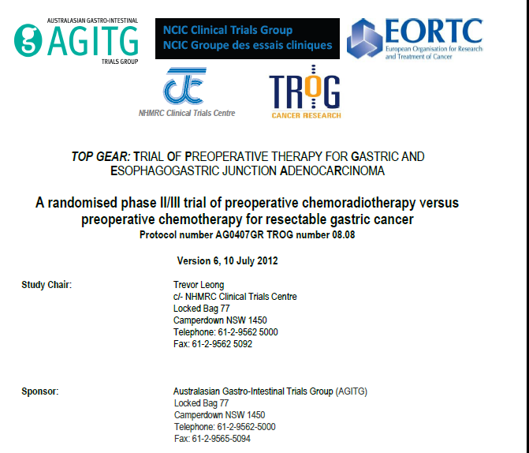

Slide 23
Topgear trial
Randomi
se
Chemo
Chemo
ECC x3
Sx
ECC x3
Chemo
Chemo
ECC x2
Chemo/XRT
Sx
ECC x3
XRT = radiation therapy
Sx = surgery

Slide 24
The role of clinical trials in Health Care
Why must we embed clinicians in this process?
Question quality of care
Test the existing evidence-base
Implement results of trials in which they are embedded
Lead to more rapid adoption
Train workforce
Provide career opportunities attracting the best to question the status quo.
Research in health care = How do we do Health Better?

Slide 25
Clinicians or Networks (CTNs) of Clinicians?
Access to sufficient sample size – thousands of patients
One-time infrastructure creation
Growing research culture
Extensive and growing corporate knowledge
Clinician-led, clinician relevant and mentoring next generation
Effectively collaborate with similar international networks
Bedside-to-beside translation of research into practice
Notes:
Bench to bedside bedside to bedside translation …

Slide 26
Conclusion
RCTs are central to a self-improving (value-based ) health system.

Slide 27
Acknowledgements
Patients
Board of ACTA
Sue Evans/Tony Keech/John McNeil/John Simes/Steve Webb

