Slide 1
The digital future Jonathan Morris

Slide 2
The digital future

Slide 3
The digital future
What do we research?
Where do we conduct our research?
How do we research?
How do we measure how well we are performing at research?
How do we measure the longer term outcomes of research ?
How do we measure implementation of research?

Slide 4
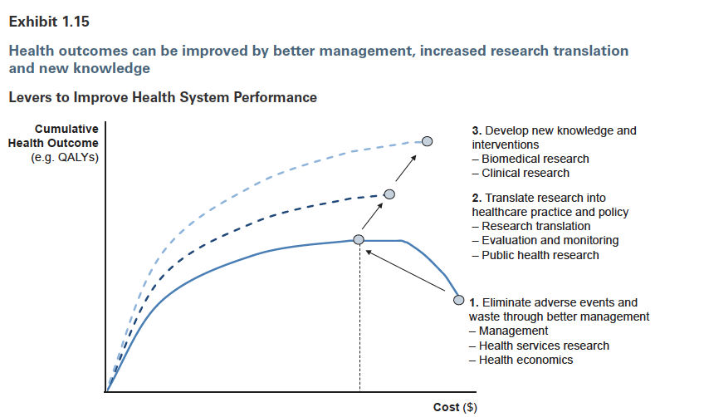
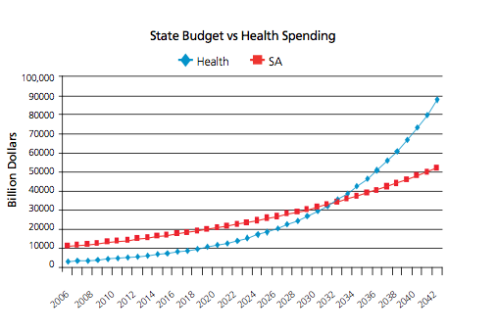
What do we research?

Slide 5
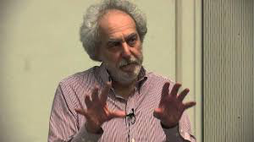
Research Questions

Slide 6
What do we research?
Asking the right questions
What’s your beat?": Reducing stroke risk through enhanced public awareness and screening for AF
Identifying and managing atrial fibrillation (AF) in rural patients aged 65 years and over by opportunistic screening using a smartphone electrocardiogram in the rural primary setting (AF SMART)
General Practitioners Screen their patients for Atrial Fibrillation and othEr aRrhythmias (GPSAFER)
Development and validation of a novel, wearable continuous ECG monitor for automated detection of atrial fibrillation in patients attending a hypertension outpatient clinic.
Evaluating the efficacy of smartphone electrographic monitoring for atrial Fibrillation detection in Acute Ischemic Stroke and transient ischemic attack patients
Identifying postoperative atrial fibrillation recurrence in non-cardiac surgical patients after hospital discharge using an iPhone electrocardiogram
Identifying atrial fibrillation (AF) in patients aged 65 years and over by opportunistic screening during the annual influenza vaccination and chronic care assessments using a smartphone electrocardiogram

Slide 7
Research Priorities

Slide 8
Gestational age by year for all hospitals in NSW- singletons

Slide 9
Gestational Diabetes

Slide 10
Where do we conduct our research?

Slide 11
Number of women reporting smoking during pregnancy

Slide 12
LHD | Number of smokers | % of all smokers
Hunter New England | 11098 | 19%
South Western Sydney | 7744 | 13%
Western Sydney | 6548 | 11%
Western NSW | 5136 | 9%
Nepean Blue Mountains | 4070 | 7%
Illawarra Shoalhaven | 3634 | 6%
Central Coast | 3372 | 6%
South Eastern Sydney | 2824 | 5%
Murrumbidgee | 2738 | 5%
Northern NSW | 2680 | 5%
Mid North Coast | 2502 | 4%
Sydney | 1890 | 3%
Southern NSW | 1682 | 3%
Northern Sydney | 1065 | 2%
Far West | 479 | 1%
The top 4 LHDs account for
50% of pregnant women who
reported smoking during
pregnancy

Slide 13
How do we research?

Slide 14
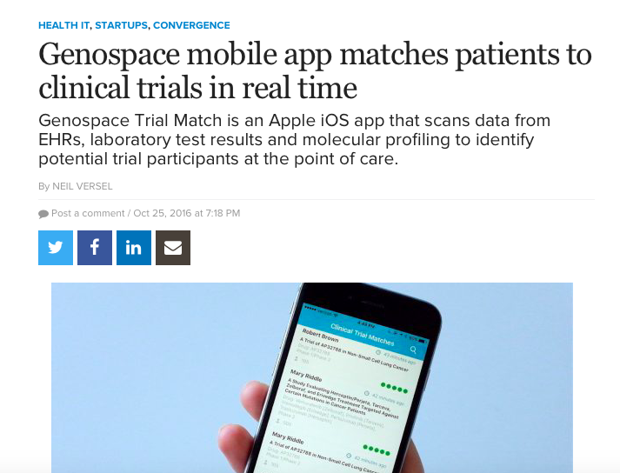

Slide 15
Data
Collect data once and use it often
Use existing systems and processes for study management

Slide 16
CiPS: Treatment of asymptomatic vaginal candidiasis in pregnant women to prevent preterm birth: a randomised trial [ACTRN12610000607077]
Aim: ‘In women with asymptomatic vaginal candidiasis early in pregnancy does treatment with clotrimazole prevent spontaneous preterm birth?’
Sample size : 3208 (1604 per group)
Eligibility: 12-<20wks, singleton, >=18yrs of age, no cervical suture, no allergy to clotrimazole
1°outcome: birth <37 wks following spontaneous onset of labour or PPROM
Sites: 9 hospitals participated over 7 years December 2010 to August 2017.
RNSH, RHW, RPA Women & Babies, Westmead, Nepean, Hornsby, Liverpool, Campbelltown and St George.
Progress: Recruitment completed August 2017.
Last women recruited birth March 2018.
Approached n=21,225
99.97% consented to access to health related records
97.9% to access to child’s educational records
Consented & Screened n=13,850 (65.3%)
Screened positive n=3240 (23.4%)
Screened negative n=10,610 (76.6%)
Treatment
n=1622
Usual care
n =1618
Birth
The University of Sydney

Slide 17
Trial entry form
For Researcher Use Only
Please use Pt Addressograph if available
Patient Details Hospital …………………….…..................
MRN………………………………………...DOB: ….. / .…. / …...
Surname………………………………………………………….....
Given Name: …....……………………………………………….…
Address ……………………………………………………………..
……………………………………… Postcode…………………...
Home ph……...……….….…Mob/wk…….……….………….…..
Email ……….……………………………………………………....
Alternate Contact Details……………………….………………..
……………………………………………………………………...
Preferred method of contact:
Home □ Mob/wk □ Email □
Highest level of completed education:
School □ College/Tafe □ University □
1) LMP ..…. / ..... /.…. or unknown □
dd mm yy
2) Gestation at trial entry: ____ wks /___days
3) EDB .....… / ….… / …...
dd mm yy
4) Early U/S ....… / ….… /……. & Gest ___wks/__ days
dd mm yy
5) Have you been pregnant before: Yes / No
If yes, how long since your last pregnancy (ended)………….. mths/yrs
6) Previous preterm birth (20 -<37wks): Yes / No
.. .If yes, gestation at delivery: ……….. (wks)
& was the preterm birth (tick all that apply)
Spont Labour □ PPROM □ or Medically indicated □
7) Have you received treatment for (vaginal?) thrush?
i) At any time in your life Yes / No
ii) During this pregnancy Yes / No

Slide 18
Recruitment and Data Collection
 |  |  | Timing (data collection)
 | Identification & screening of eligible women (N=16,040)* |  | Routine antenatal visit at 12-19+6 (baseline data, Candida testing)
 | ↓
 | Randomisation of women with asymptomatic Candida (n=3208) |  | <1 week after Candida testing
 | Clotrimazole ↓ | Usual care ↓
 | Follow-up | Follow-up | ~ 30 weeks gestation (questionnaire)
 | ↓ | ↓
 | Birth | Birth | 1º and 2º outcomes collected from ObstetriX, NICUS and HIE database
* primary outcome data (preterm birth rates) will be obtained for all women screened regardless of the result

Slide 19
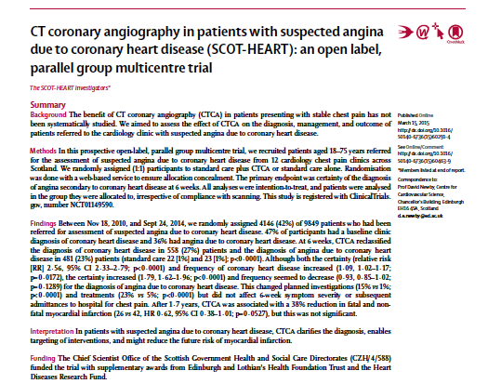
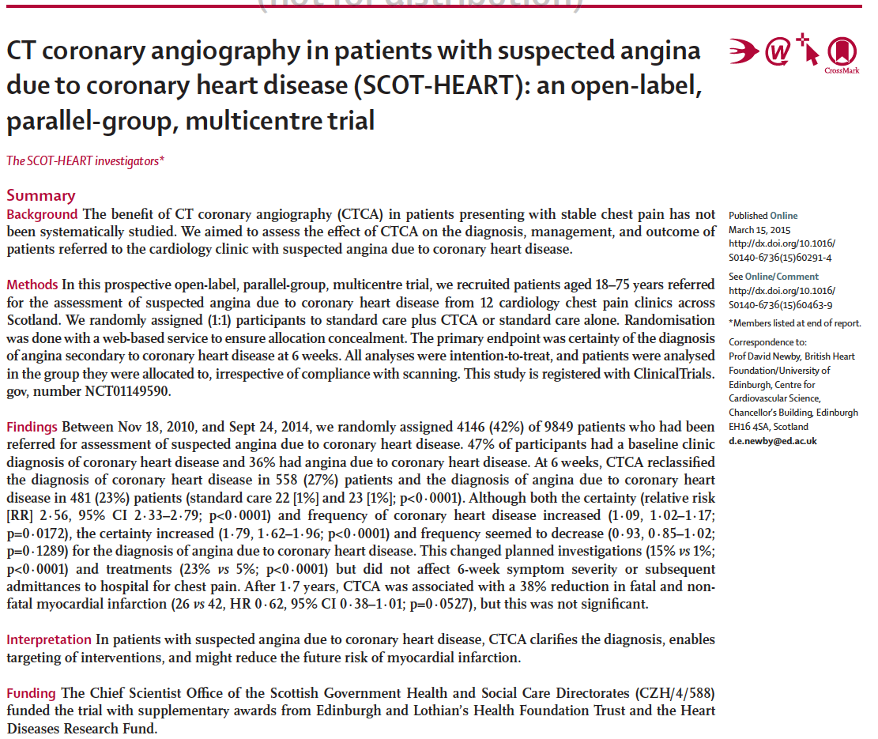
Published Online
Notes:
The SCOT-HEART Trial is now available online in the Lancet.

Slide 20
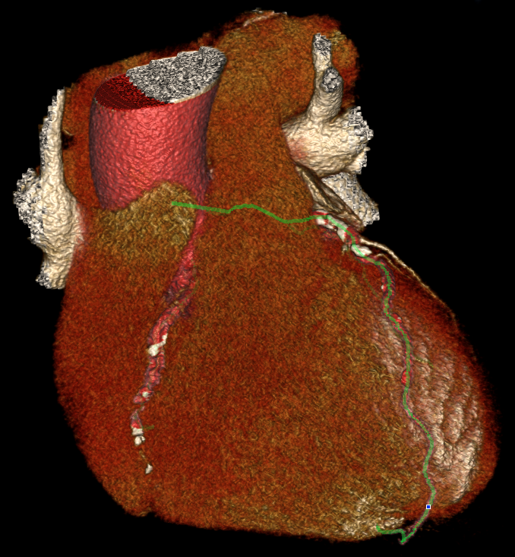
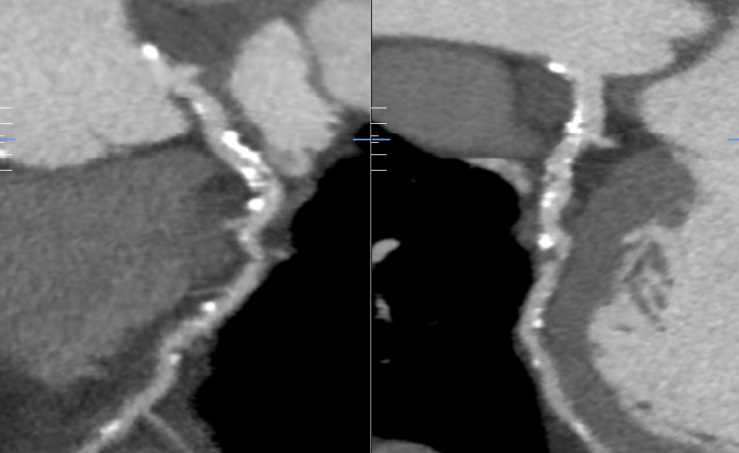
Computed Tomography Coronary Angiography
90-95% Specific and Sensitive for Coronary Heart Disease
Male, 55 years, Calcium Agatston Score 1,400
Schroeder et al. Eur Heart J 2008;29:531–556
Williams et al. Heart 2011;97:1198-1205

Slide 21
Scottish COmputed Tomography
of the HEART (SCOT-HEART) Trial
Trial Centers
Complete Health
Record Data Capture
One National
Healthcare Provider
12 Centers Across
Scotland
Perth Royal Infirmary, Perth
64
Ninewells, Dundee
Victoria Hospital, Kirkcaldy
64
Forth Valley Hospital, Larbert
320
Western General Hospital, Edinburgh
Royal Alexandra Hospital, Paisley
Royal Infirmary, Edinburgh
Western Infirmary, Glasgow
Glasgow Royal Infirmary, Glasgow
St John’s Hospital, Livingston
University Hospital, Ayr
Borders General Hospital, Melrose
Notes:
There were 12 recruiting centres across the central belt of Scotland. Participants underwent CT coronary angiography at 3 imaging centres with 64 and 320-row scanners. In Scotland, we have a single health care provider, NHS Scotland. NHS Scotland has a comprehensive and robust electronic health care system that enables us to obtain complete follow up of all clinical events in all of our patients.

Slide 22
Scottish COmputed Tomography
of the HEART (SCOT-HEART) Trial
Trial Population
Patients Referred for Evaluation
of Suspected Angina due to
Coronary Heart Disease
n=9,849
Only 11% of All Patients
Excluded From the Trial
Ineligible Patients
n=1,082
Eligible Patients for
SCOT-HEART trial
n=8,767
Eligible Non-recruited
Patients n=4,621
Missing 137
Patient preference 2613
Clinician choice 547
Not Approached 992
Other 332
Eligible Recruited Patients for
SCOT-HEART trial
n=4,146
Randomization 1:1
n=4,146
47% of Eligible Patients
Recruited Into the Trial
Notes:
Over the 4 years of the trial, nearly 10,000 patients presented to the 12 Cardiology centres of whom nearly 9000 were eligible for inclusion. One half of all eligible patients were recruited into the trial. I believe this inclusivity is a major achievement that is rarely, if ever, seen in randomised controlled trials and is a testament to the hard work of all the SCOT-HEART trialists.

Slide 23
How do we measure how well we are performing at research?

Slide 24
How do we measure how well we are performing at research?
Number of studies that have no recruits within 180 days approach 50% in some LHDs
The number of studies that close having reached recruitment targets is very low

Slide 25
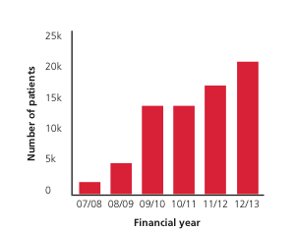
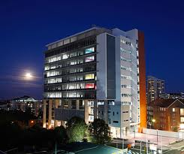
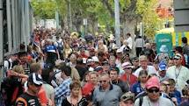

Slide 26
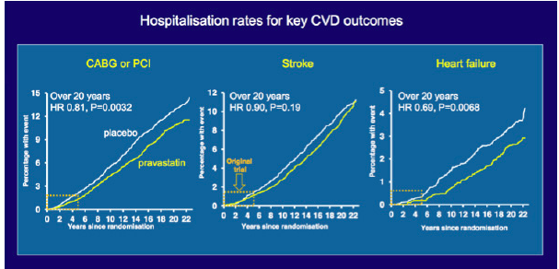
How do we measure long term outcomes?
Record linkage and eHealth innovation can be used to make the planning and conduct and follow up of clinical trials more efficient

Slide 27
Measuring implementation of research

Slide 28
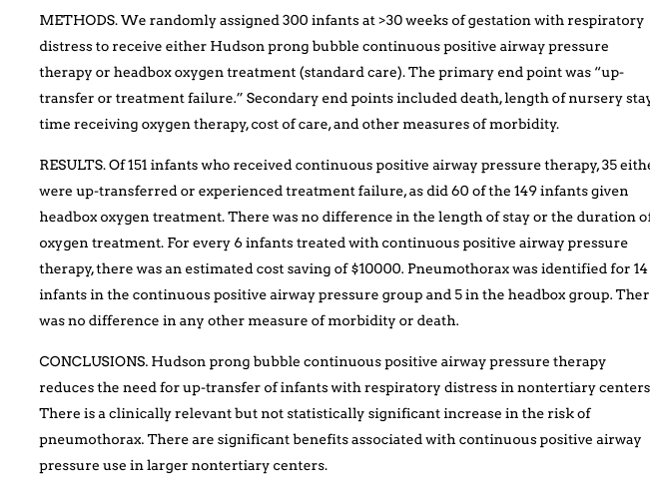
Measuring implementation of research

Slide 29
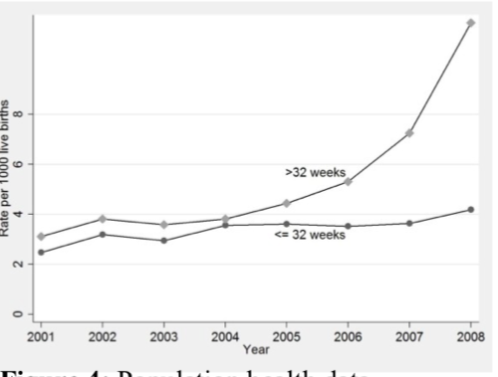
Measuring implementation of research: CPAP usage in NSW following a RCT

Slide 30
The Digital future
Thoughtful engagement with the digital future can make our studies and their impact:
More relevant
More efficient
More effective
More evaluable
And this will lead to quicker transformation of health

