Slide 1
Return on investment of clinical trials
Associate Professor Rachael Morton
Director of Health Economics
NHMRC Clinical Trials Centre

Slide 2
Return from clinical trials
Potential outputs
  Knowledge produced
  Clinical guidelines (practice changing)
  Health benefits
  Informing health policy
  Economic benefits
  Research capacity building
  Informing product development
Notes:
There are several gains from clinical trials
New knowledge is produced e.g. that its better to wait a minute before clamping the cord
This knowledge can change practice – through changes in guidelines
Health benefits, longer survival and better quality of life
New policies – e.g. population based cancer screening
Broader benefits to the economy such as productivity gains (return to employment); savings to the health system through disinvestment in ineffective treatments
Technical skills, e.g. trial biostatisticians, trial health economists, clinician trialists
Particularly early phase trials - Future drug, device or test development

Slide 3
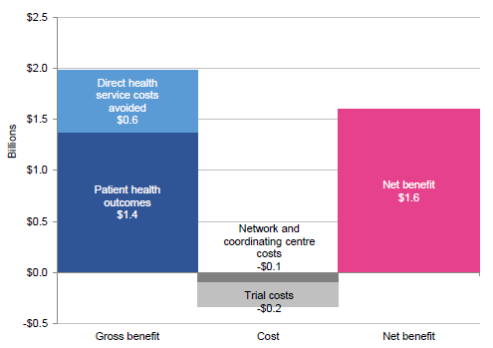
Clinical trials are excellent value for money
Benefits estimated $2 billion¹
Benefits gained through both improvements in patient health outcomes and savings from direct health service costs avoided
When trials costs deducted, net benefit $1.6 billion
With a total gross benefit of almost $2 billion and a total cost of $335 million, the benefit to cost ratio is 5.8 :1
Every dollar invested returns $5.80
¹Australian Commission on Safety and Quality in Health Care. Economic evaluation of investigator-initiated clinical trials conducted by networks. (2017)
Notes:
This bold claim comes from a report by the Australian Commission for Safety and Quality in Health Care, which analysed 25 high-impact investigator-initiated trials across 3 networks: ASTN, (Stroke Trials), IMPACT (Perinatal trials) and ANZICS (Intensive care trials).
The benefits of these trials in the blue bar, assuming trial findings were implemented 65% of the time (practice / policy), in the at risk population over their lifetime would be a $2 billion. This is made of both improvements in health outcomes (survival and quality of life) – [one year of life in full heath valued at $180,000]; plus savings from stopping health services that were ineffective. (reduction in number of caesarean sections, increase in vaginal deliveries).
The grey bar shows the actual costs of doing these 25 trials ($335 million). The pink bar shows the net benefit - $2billion minus $335 million = net benefit of $1.6billion. Or a ratio of 5.8 to 1. Which means that for every dollar invested in these clinical trials the return was $5.80.

Slide 4
International Example: Economic return from the Women’s Health Initiative (E+P) trial
One of NIH’s most expensive trials
  (US$260 million in 2012 dollars)
Hypothesis - combined hormone therapy coronary heart disease, osteoporosis
2002 – Trial stopped. Main findings:
  coronary heart disease, stroke, pulmonary embolism
  breast cancer risk
  colorectal cancer & fractures
JAMA 2002;288:321-333
Notes:
Now to some examples – starting with a large international trial and a study that tries to answer the question of what would happen if the trial were not done?
The Women’s Health Initiative (combined hormone therapy trial) (Estrogen and Progestin) was one of the NIH’s most expensive trials, costing 260 million US dollars. The trial recruited >16,000 women in 1993-1998. It was stopped early by the DSMB in 2002 after a mean of 5.2 years follow up due to concerns about the high rate of breast cancer observed among women in the intervention arm.

Slide 5
Economic return from the Women’s Health Initiative trial
Decision model:
  to simulate the health outcomes from WHI trial with observed cHT use vs ‘no WHI trial’ with cHT extrapolated from the pre-trial period
10 year time horizon (2003-2012)
Perspective of the US health system
Ann Intern Med 2014;160:594-602
Notes:
Economists decided to model what did happened after this trial, with what would have continued if the trial had not been done.
They used a decision model to simulate both sets of events on the US population over a ten year period. i.e. 2003-2012.

Slide 6
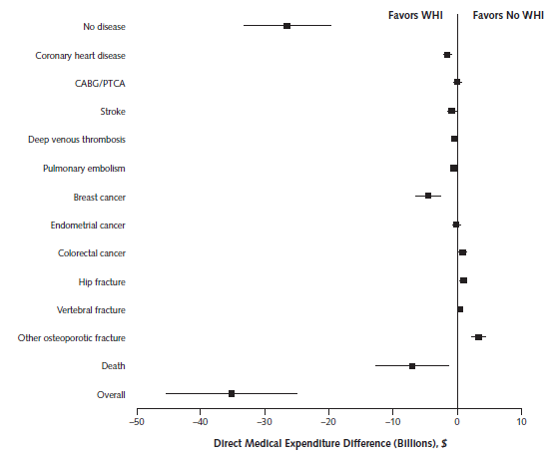
Results - Difference in expenditure WHI trial vs no trial
Results:
4.3M fewer cHT users
126,000 fewer breast cancer cases
76,000 fewer CHD cases
263,000 more fractures
= Net benefit $37.1 billion
Notes:
Explain forest plot
Applying implementation assumptions of….. there would be 4.3 million less HRT users
over 10 years; resulting in 126,000 fewer breast cancers; 76,000 few cases of coronary heart disease; but more fractures. The net benefit of less heart disease and breast cancers (in terms of both extended survival and improved quality of life) was $37.1 billion. Not a bad return to society from $260 million.

Slide 7
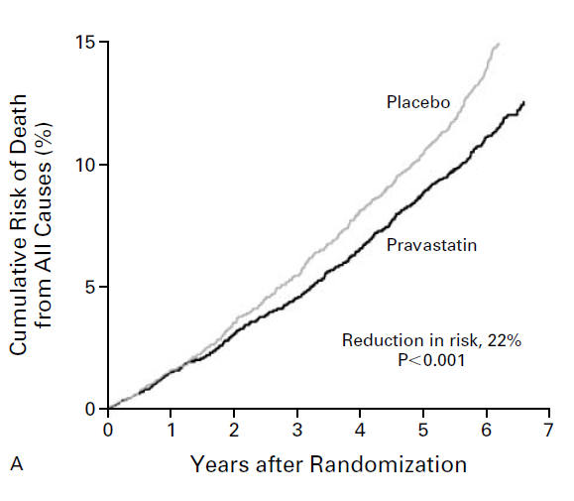
CTC Examples: The LIPID Trial
Pravastatin improved survival in patients with coronary heart disease and with average cholesterol levels
Trial led directly to change in Australian guidelines and in Pharmaceutical Benefits Scheme
Significant impact on international guidelines
Estimated cost-effectiveness $6,300 per LY gained
LIPID Study Group. NEJM 1998; 339:1349-57.
Notes:
The LIPID trial which Phil spoke about already was practice changing. But what is the long term economic benefit? At 8 years, Pravastatin prevented 58 deaths , MIs, strokes and events per 1,000 patients. (Lancet 2002) The incremental cost effectiveness ratio of this treatment compared to no treatment was $6,300 per life year gained. Which represents very good value for money. A cheap intervention. The value of this trial (and other statin trials) then in terms of change in practice and benefits to future patients can be multiplied by the number of people at risk to calculate the total benefit to society.
38 deaths * $180,000 = $6.9M just for the trial participants.

Slide 8
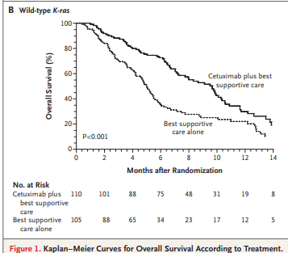
CTC examples: CO17
All survival benefit occurred in patients with K-ras wild type tumours
No benefit at all in patients with K-ras mutated type
Significant difference in treatment effects between the 2 groups (p<0.01)
K-ras now being routinely incorporated into practice for clinical practice and for future trials using therapies targeted at the EGFR receptor pathway
NEJM 2008; 359:1757-65
Notes:
This trial you have also seen before. Cetuximab in people with colorectal cancer. The figure to the right shows the difference in survival for people with the K-ras wild type tumour. The economic benefit is two-fold. Firstly, prescribing a targeted drug to a group known to benefit – improved survival ($180,000 for a full year in perfect health), and secondly stopping prescribing to a group who would not benefit (those with mutated K-ras tumours).

Slide 9
CTC examples: ASPIRE
Patient Population:
First episode of unprovoked proximal DVT and/or PE, and
Completion of initial anticoagulant treatment (recommended 3 – 12 mths)
Stratification
Baseline variables
Institution
Patients with history of unprovoked venous thromboembolism
Aspirin (100 mg daily)
Registration
Rand
Double-blind treatment 2-4 years
Completed anticoagulant treatment
Placebo
Follow up at 1 and 3 months and 3 monthly intervals thereafter
Notes:
ASPIRE was a trial conducted by the CTC using aspirin for the treatment of recurrent venous thrombo-embolism (clots in your legs DVT or your lungs PE). Patients were randomised to aspirin or placebo. 822 patients

Slide 10
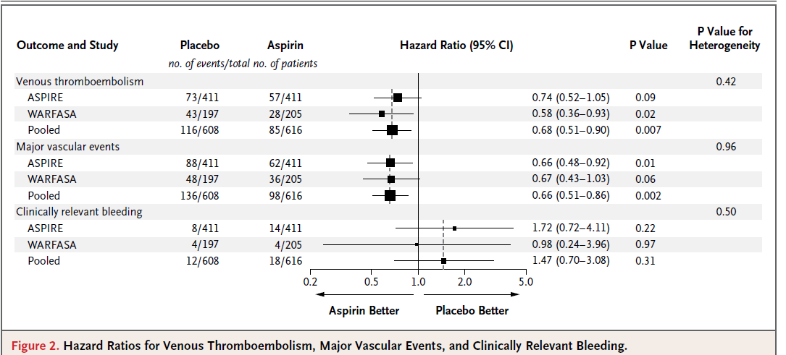
CTC examples: ASPIRE & WARFASA
When the findings from ASPIRE and WARFASA (a similar trial were pooled in a pre-planned meta-analysis) aspirin prevents about one third of recurrent thrombotic events: for every 1000 patients treated for 1 year, aspirin can be expected to prevent about 20 to 30 episodes of recurrent major thrombotic events at the cost of about 3 significant bleeding episodes.
Notes:
Aspirin for 1 year prevents 1/3 of VTEs; and carries a very small risk of significant bleeding 3/1000 – 0.003%

Slide 11
ASPIRE trial net benefit
15,000 new cases of VTE each year (~ 5,000 cases unprovoked VTE ) [AIHW]
Cost of VTE each year is $1.7 billion (lost income) + $150 M in healthcare costs [Access Economics report 2008]
Additional healthcare costs for patients having a DVT or PE ~ $10,000 per case of VTE (2008 $)
Treatment of every 1,000 cases with aspirin per year could conservatively result in 25 fewer recurrent episodes of VTE or other major thrombotic events at a cost for 3 extra bleeding episodes: net saving of over $200,000
Aspirin has the potential to used in several thousand patients worldwide who have had an unprovoked VTE and are not (or no longer) taking anticoagulant therapy at significant savings to the health care system ($$M)
The cost of the ASPIRE trial itself ($4.5 M) recouped within 1 to 2 years
Notes:
What is the economic benefit of all this?
Access Economics COI report – 2008.

Slide 12
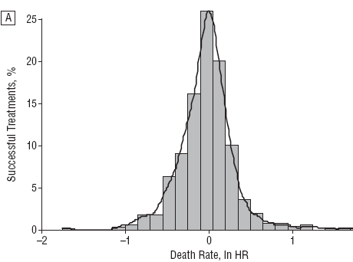
Why is future investment in clinical trials essential?
Little to no survival advantage of new treatments vs standard over past 50 years
Mix of major advances, equivalent benefit and some inferior new treatments
Clinical trials will continue to be needed to help distinguish real advances in cancer care from false hope
Favours new Rx
Favours old Rx
New = Old
Djulbegovic et al. Treatment success in cancer. Review of NCI-sponsored phase III trials: 1955 – 2006. Arch Intern Med. 2008
Notes:
Phase III cancer trials sponsored by the NCI – 624 trials

Slide 13
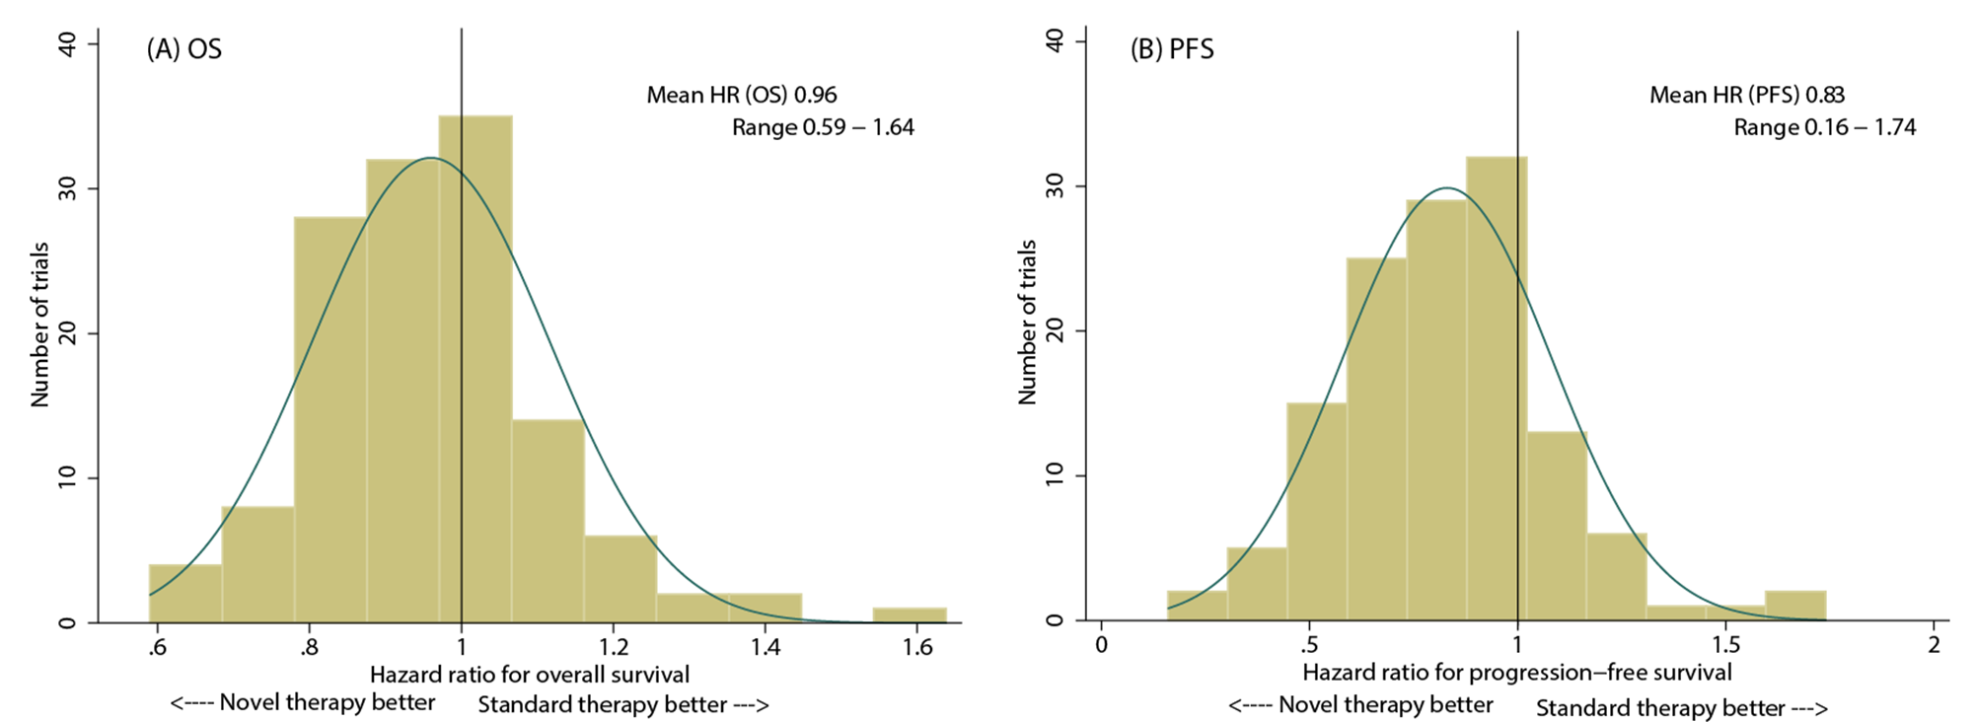
Randomised trials still needed for novel biologic anticancer therapies
Cho et al ESMO 2016; JCO Precision Oncology 2017

Slide 14
Future investment in clinical trials, demonstrating their return
Value of information analysis
  Additional value of collecting new data in a randomised trial to reduce the current uncertainty in clinical decision making
  Pre-trial modelling at the CTC
Payback methods
  Examining the monetary return from completed trials and change in practice

Slide 15
Summary
Clinical trials often require a large budget, however have been shown to provide substantial returns on investment through:
  Improvement in health outcomes (survival, quality of life)
  Cost savings through discontinuation of ineffective treatments
The NHMRC Clinical Trials Centre has demonstrated impressive return from several trials conducted over the last 30 years
Future research investments could be allocated based on expected trial returns to society

