Slide 1
Cancer Trials
30 years in the making
Professor John Simes
Director, NHMRC Clinical Trials Centre

Slide 2
Goals
Mission
To achieve best practice in health care and
improve outcomes in Australia and internationally through the better use of clinical trials research
Generate high quality evidence of the effectiveness of
health care interventions through randomised trials
Be a national resource in design, conduct analyses and
interpretation of randomised trials
Improve evidence-based health care through the
better use of clinical trials and high quality
systematic reviews of trials

Slide 3

1
  Well-designed trials of high quality
  OUR APPROACH
2
  Potential to impact of future clinical practice and health policy
3
  Likelihood of success based on track record and feasibility
4
  High anticipated public value based on return on investment

Slide 4
Oncology trials over 30 years
Has conducted over 150 clinical trials in cancer
Over 850 clinical trial sites nationally and internationally
With more than 22,000 clinical trial participants enrolled on a trial at CTC
Worked in collaboration with many national and international cancer clinical trial groups
Notes:
Placeholder slide for Burcu

Slide 5
Collaborators
CTC is coordinating centre for 5 national cancer cooperative groups (NCCTGs) and has helped establish these Groups
  2000: Australasian Gastro-Intestinal Trials Group (AGITG)
  2000: Australia New Zealand Gynaecological Oncology Group (ANZGOG)
  2004: Australasian Lung Cancer Trials Group formed (ALTG)
  2007: Cooperative Trials Group for Neuro-Oncology (COGNO)
  2008: Australian and New Zealand Urogenital and Prostate Cancer Trials Group (ANZUP)

Slide 6





Cancer collaborative groups
AGITG
ANZGOG
Australian & New Zealand Gynaecological Oncology Group
ALTG
Australasian Lung Trials Group
COGNO
ANZUP
Australasian Gastrointestinal Trials Group
Cooperative Oncology Group for Neuro-Oncology
Australian and New Zealand Urinary and Prostate Trials Group
EORTC, ECOG, ESPAC, MRC, CCTG, NSABP, PETACC, CTERU, OCTO, CACTUS, GERCOR
USGOG, IGCI, GCIG, GINECO, SGCTG, MRC, DGOC
CTG, NVALT
EORTC
MRC, CTG, CRUK, EORTC, GERCOR, NCRI, CTI

Slide 7



Further collaborations
Group | CTC Role
ANZBCTG – now Breast Cancer Trials (BCT) | Statistical Centre (30 yrs)
TROG, ANZMTG, PC4 | Biostatistics / Health Economics
Aust Breast and Colorectal Surgical Groups | Coordinating Centre
International Gyn Groups | Statistical Centre
Sydney Catalyst | Trials / Statistical Support
Australian Genomic Cancer Medicine Centre | Trials Centre

Slide 8
Clinical trials impacting practice and outcomes
Wide range of trials of chemotherapy, radiation therapy, surgery, biological therapies and supportive care
Improvements in survival (eg. breast cancer, germ cell, colon cancer, glioma)
Improvements in quality of life and cancer control (including in breast, colon, gastric, oesophageal, pancreatic, respiratory, ovarian cancers and palliative care)
Lack of benefit / cautionary notes for some treatments such as
  routine antidepressants for symptoms of depression;
  laparoscopic surgery for rectal cancer and for cervical cancer;
  A number of novel therapies, where promise of earlier results, not realised

Slide 9
Clinical trials impacting practice and outcomes
Wide range of trials of chemotherapy, radiation therapy, surgery, biological therapies and supportive care
Improvements in survival (eg. breast cancer, germ cell, colon cancer, glioma)
Improvements in quality of life and cancer control (including in breast, colon, gastric, oesophageal, pancreatic, respiratory, ovarian cancers and palliative care)
Lack of benefit / cautionary notes for some treatments such as
  routine antidepressants for symptoms of depression;
  laparoscopic surgery for rectal cancer and for cervical cancer;
  A number of novel therapies, where promise of earlier results, not realised

Slide 10
Clinical trials impacting practice and outcomes
Wide range of trials of chemotherapy, radiation therapy, surgery, biological therapies and supportive care
Improvements in survival (eg. breast cancer, germ cell, colon cancer, glioma)
Improvements in quality of life and cancer control (including in breast, colon, gastric, oesophageal, pancreatic, respiratory, ovarian cancers and palliative care)
Lack of benefit / cautionary notes for some treatments such as
  routine antidepressants for symptoms of depression;
  laparoscopic surgery for rectal cancer and for cervical cancer;
  A number of novel therapies, where promise of earlier results, not realised

Slide 11
Breast cancer: which surgery?
Sentinel node biopsy v axillary clearance for women with early stage breast cancer
SNAC trial (in collaboration with RACS)
Finds patients should opt for minimally invasive sentinel node biopsy management instead of routine axillary clearance surgery
Newer treatment results in better quality of life (less lymphoedema) for patients
Now the standard of care

Slide 12
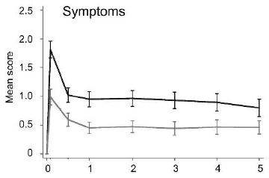
SNAC
Percent increase in arm volume from baseline
Sentinel node based management vs routine axillary clearance in
1,088 women with early breast cancer
Collaboration with the
Royal Australasian College of Surgeons
Sentinel node based management reduced arm swelling (p<0.001) and improved quality of life (p<0.001)
Trial Incorporated training of surgeons – now routine practice at major centres
SNAC Trial Group, Annals Surg Oncol 2017

Slide 13

Gene mutations drive colorectal treatment
Study together with AGITG and Canadian Cancer Trials Group
Tumours respond well to biotherapy (cetuximab) provided the patient does not have a KRAS mutation in their genes
International guidelines go on to recommend patients be genetically tested before tumours are treated
Saves patients from unnecessary treatments and healthcare sector millions globally

Slide 14
Trials to basic science – CO17
All survival benefit occurred in patients with K-ras wild type tumours
No benefit at all in patients with K-ras mutated type
Significant difference in treatment effects between the 2 groups (p<0.01)
K-ras now being routinely incorporated into practice for clinical practice and for future trials using therapies targeted at the EGFR receptor pathway
NEJM 2008; 359:1757-65

Slide 15
Leading international collaborations
In many international trials we have contributed to studies coordinated by overseas groups
Several examples where we have coordinated international efforts from Australia:
  TOPGEAR – gastric cancer – with AGITG
  INTEGRATE – gastric cancer – with AGITG
  ENZA trials – prostate cancer – with ANZUP
  DREAM – immunotherapy in mesothelioma – with ALTG
  OUTBACK – chemotherapy in cervical cancer – with ANZGOG

Slide 16
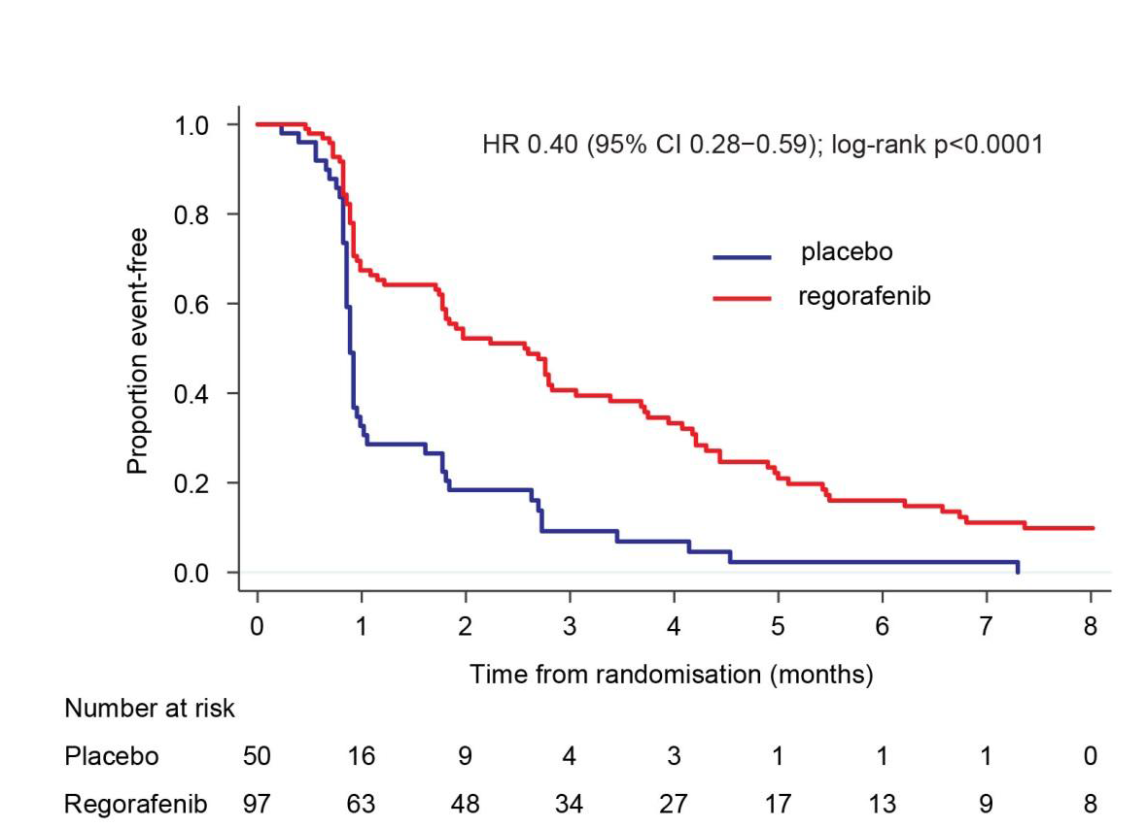
INTEGRATE: gastric cancer
AGITG Study with CTC
Randomised phase II trial of regorafinib versus best supportive care (with placebo) in patients with advanced gastric cancer
Has now led to a phase III trial in Asia, Australasia and North America

Slide 17
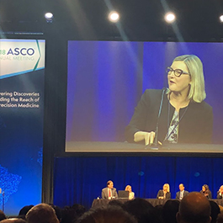
DREAM: Immunotherapy worth the hype?
How to treat malignant pleural mesothelioma (lung cancer), the DREAM study
Study together with ALTG
Novel treatment in patient group with unmet needs → trial recruited very fast
Initial results show chemo-immunotherapy has better response to treatment and progression free survival at 6 months than chemotherapy, with acceptable tolerability

Slide 18
Precision medicine trials
Growth in trials for rare cancers and rarer subgroups of patients
MOST program: signal-seeking studies of targeted therapies
Collaborative research involving many groups (basic science, industry, bioinformatics, biostatistics, trialists)
Development of reliable surrogates for screening new treatments (based on biomarker profiles)
Validation studies to confirm predictive value of biomarkers
Continued reliance on phase III randomised trials (but with smaller sample size if well targeted)
New regulatory framework for evaluating and approving new therapies

Slide 19
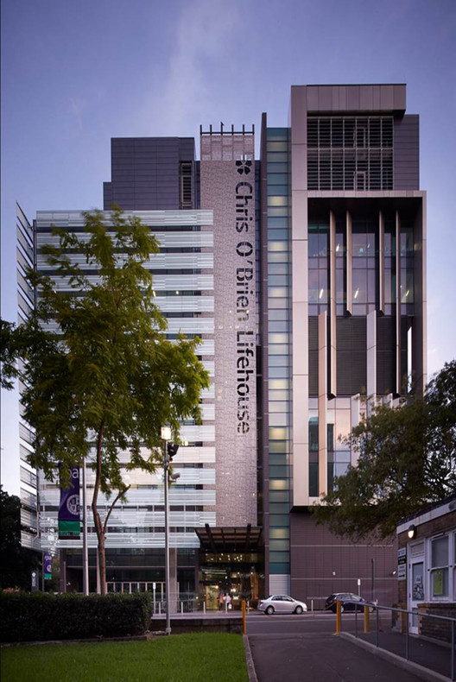

Thank you
To our valued collaborators, investigators, government, industry and patients / consumers
@TrialsCentre

Slide 21

The next 30 years…
Australians living longer and health conditions improving
Large trials still needed, but trials must positively impact patients and budgets
Challenges:
  Best use of digital technology to optimise health care decisions
  Link trials to patient molecular profiles
  Better integration between research and practice
Same end game:
  Clinical trials inform best practice, and best practice results in better patient outcomes

