Slide 1



Cardio –Metabolic :30 years in 10 minutes
Philip Aylward
March 2019

Slide 2

Research Grants, Advisory Board, Speaker for:
Astra Zeneca, Sanofi Aventis, Amgen,
CSL, Merck , Boehringer Ingelheim,
Bayer/J&J, Pfizer
Bristol Myers Squibb, Novartis

Slide 3
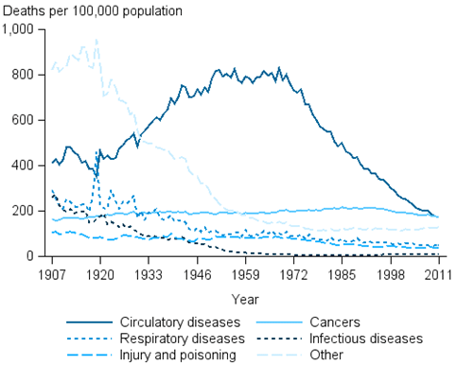
Australian Causes of Death

Slide 4
Reasons for Decline in Cardiac Mortality
Better Treatments
Risk Factor Management
NHMRC CTC involved in Landmark Trials to improve both

Slide 5


Acute MI - In Hospital Mortality
1980 13% Pre Fibrinolysis
1990 8% Fibrinolysis/Aspirin/Heparin
2000 6% PCI/ New Fibrinolytics
2010 3% Primary PCI/Pharmaco-Invasive

Slide 6
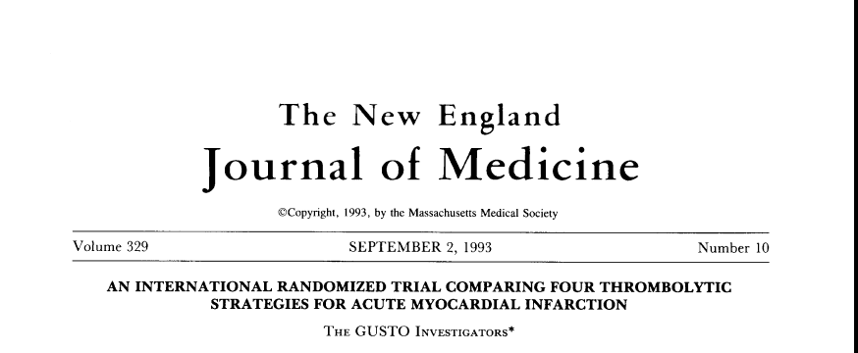

NEJM 1993; 329: 673-682.

Slide 7
GUSTO
Final
Enrollment
Australia 2,287 59
Belgium 2,030 73
Canada 2,898 63
France 1,239 62
Germany 1,282 73
Ireland 185 13
Israel 2,944 25
Netherlands 2,299 43
New Zealand 666 17
Poland 360 15
Spain 467 13
Switzerland 209 6
United Kingdom 1,050 22
United States 23,105 597
TOTAL 41,021 1081
# Pts.
Enrolled
# Enrolling
Centers
41,021

Slide 8
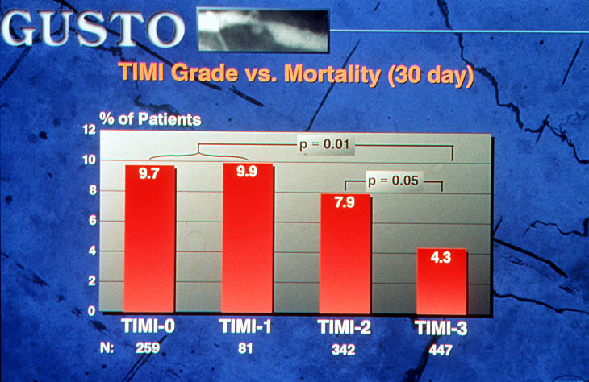

Coronary Artery Reperfusion in STEMI
Simes RJ et al. Circulation 1995;91:1923-1928

Slide 9

VIGOUR Centres
Uppsala Clinical Research Centre Uppsala ,Sweden
Canadian VIGOUR Centre, University of Alberta Canada
Duke Clinical Research Institute, Duke University, USA
Leuven Coordinating Centre, University of Leuven, Belgium
National Health & Medical Research Council - Clinical Trials Centre, University of Sydney, Australia
UCR
CVC
LCC
DCRI
TANGO
ECLA
NHMRC
CTC
Estudios Cardiologicos Latino America, Rosaria, Argentina
Flinders Coordinating Centre, Adelaide, Australia
FCC
Trials Argentine Group Organisation, Buenos Aries, Argentina
GLCC
Greenlane Coordinating Centre, Auckland, New Zealand

Slide 10

VIGOUR Trials
1990-2018
Acute Coronary Syndromes
GUSTO Trials (1-5) ASSENT Trials (1-4)HERO 2
PARAGON, SYMPHONY SYNERGY Early ACS,
PLATO ,TRACER
Lipids
IMPROVE-IT, ODYSSEY,STABILITY,AEGIS
Heart Failure
VALIANT, APEX

Slide 11
Long-Term
Intervention with
Pravastatin in
Ischaemic
Disease
N Engl J Med 1998;339:1349-1357
Notes:
VG
97SEP25

Slide 12
LIPID Study
87 participating centres
Australia – 67
New Zealand – 20
9014 patients
randomised
National Heart
Foundation
NHMRC Clinical
Trials Centre
Clinical Trials
Research Unit
Central Lipid
Laboratory
11,106 patients
registered
Notes:
EC
97OCT07

Slide 13
Total mortality
For all patients in the LIPID study
Mean LDLC 2.46 mmol /l
N Engl J Med 1998;339:1349-57

Slide 14
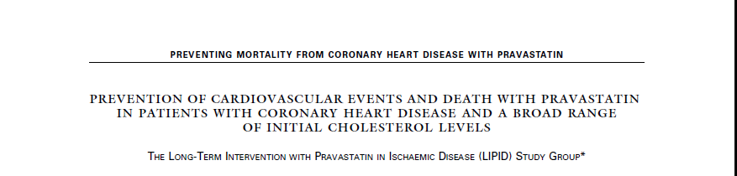

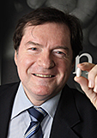
N Eng J Med 1998,339:1349-57

Slide 15
The global role of the LIPID trial
Shift from high cholesterol to high risk (e.g. in 2ndry prevention, concept that whatever the cholesterol, it is too high for that person’s arteries)
First evidence of mortality reductions from statins even when TC is average
Confirmation of excellent safety profile of statins long-term
Resolution of early breast cancer concerns (CARE)
Supporting the legacy effects of early statin use
Rich source of biomarker research to be understand mechanisms of vascular biology and disease

Slide 16
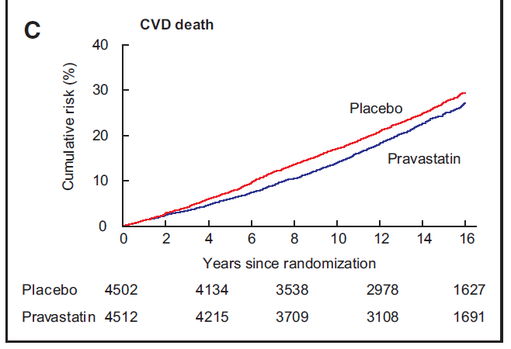
LIPID 16 year Follow UP
Circulation 2016; 133(19): 1851-60

Slide 17
Relation between the proportional reduction in
MAJOR VASCULAR EVENTS and mean absolute LDL-C reduction
in 14 statin trials
50%
40%
30%
Proportional reduction in MVE rate (±1 SE)
20%
10%
0%
0.5
1.0
1.5
2.0
-10%
Reduction in LDL cholesterol (mmol/L)
Lancet 2005; 366: 1267-78

Slide 18
FOURIER TIMI 59
Median LDL-C levels over time:
2.6
2.4
2.2
Placebo
Median 2.38 mmol/L
2.0
1.8
1.6
59% mean reduction (95% CI 58-60), p < 0.001
Absolute reduction: 1.45 mmol/L (95% CI 1.43–1.47)
1.4
LDL cholesterol (mmol/L)
1.2
1.0
0.8
Evolocumab
Median 0.78 mmol/L
0.6
0.4
0.2
0.0
0
4
12
24
36
48
60
72
84
96
108
120
132
144
156
168
No. at risk
Weeks
Placebo
13,779
13,251
13,151
12,954
12,596
12,311
10,812
6,926
3,352
790
Evolocumab
13,784
13,288
13,144
12,964
12,645
12,359
10,902
6,958
3,323
768
LDL-C was significantly reduced in the evolocumab group (median: 0.78 mmol/L) including 42% who achieved levels ≤ 0.65 mmol/L vs < 0.1% in the placebo group
Data shown are median values with 95% confidence intervals in the two arms; ITT.
Sabatine MS, et al New Engl J Med [published online ahead of print March 17, 2017]. doi: 10.1056/NEJMoa1615664
Notes:
Sabatine, et al. NEJM 2017:
4-A-1 (Figure 1)
Sabatine, et al. NEJM 2017:
3-B-3

Slide 19
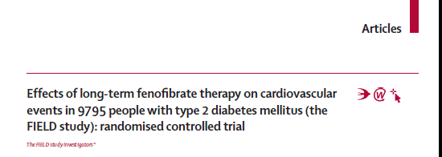

Slide 20
FIELD: Primary Endpoint
Composite CHD death or nonfatal MI at 5 Years
(% of treatment arm)
p=0.16
The primary composite endpoint of CHD death or non-fatal MI was not significantly lower in the fenofibrate group compared to the placebo group.

Slide 21
Positive results from a ‘negative’ trial
FIELD Study (n=9795)
Reduced non-fatal MI -24% p=0.01
CVD events in dyslipidemics: -27% p=0.005
Reduced laser for retinopathy: -37% p=0.0003
Reduced albuminuria progression: -14% p=0.0009
Reduced loss of GFR: -72% p=0.0003
Reduced amputation events: -37% p=0.02
Reduced monofilament neuropathy:-17% p=0.02
ACCORD Lipid Study (n=5518)
Reduced CVD in dyslipidemics: -31% p=0.03
Reduced retinopathy endpoints: -40% p=0.006
Reduced albuminuria development:-12% p=0.01

Slide 22
Cardio –Metabolic Summary
Major Improvements in Cardiac Outcomes
More Evidence in Cardiology than any other Area of medicine
NHMRC CTC have been Major Contributor to development of the Evidence Locally and Internationally.

Slide 24
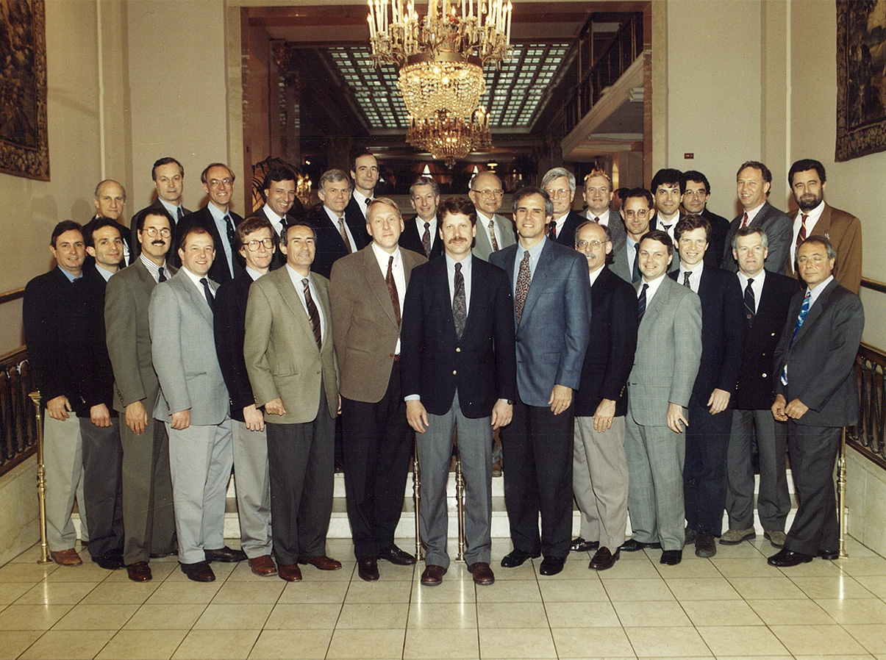

Slide 25
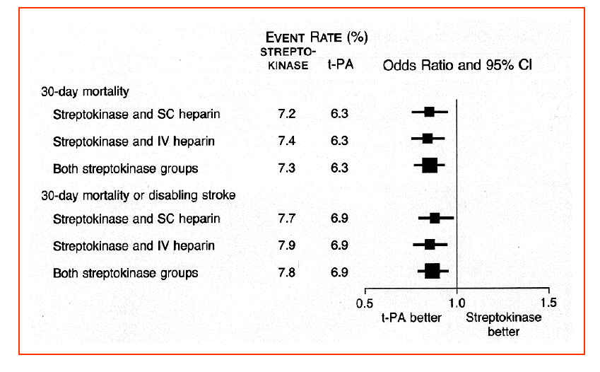
The GUSTO-1 Trial
The GUSTO Investigators NEJM 1993; 329: 673-682.

